Slide 1
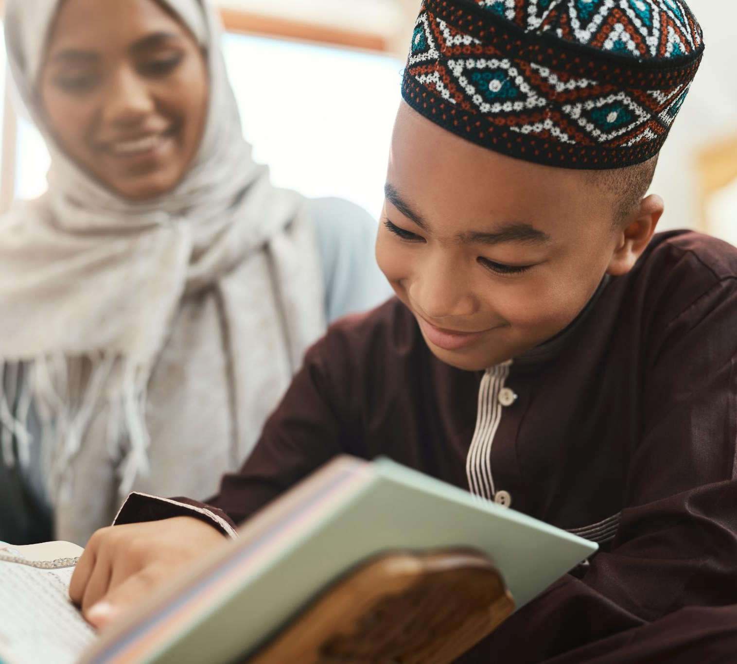
WHat do muslims believe about god?
Notes:
---

Slide 2
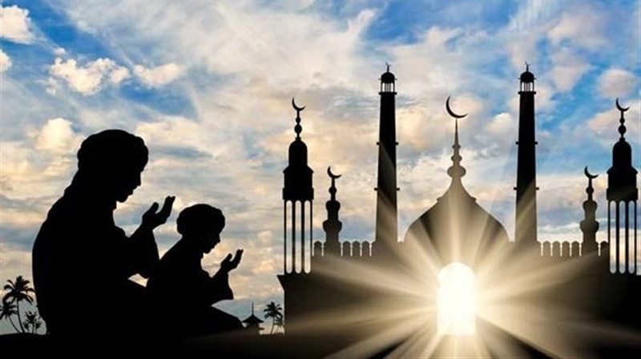
Lesson 1: What do you know already about muslims and their faith islam?
Notes:
Create a mindmap with the children to establish what they might know collectively about the Muslim faith and people. Take the opportunity to capture their thoughts, listening for any possible prejduice or negativity.

Slide 3
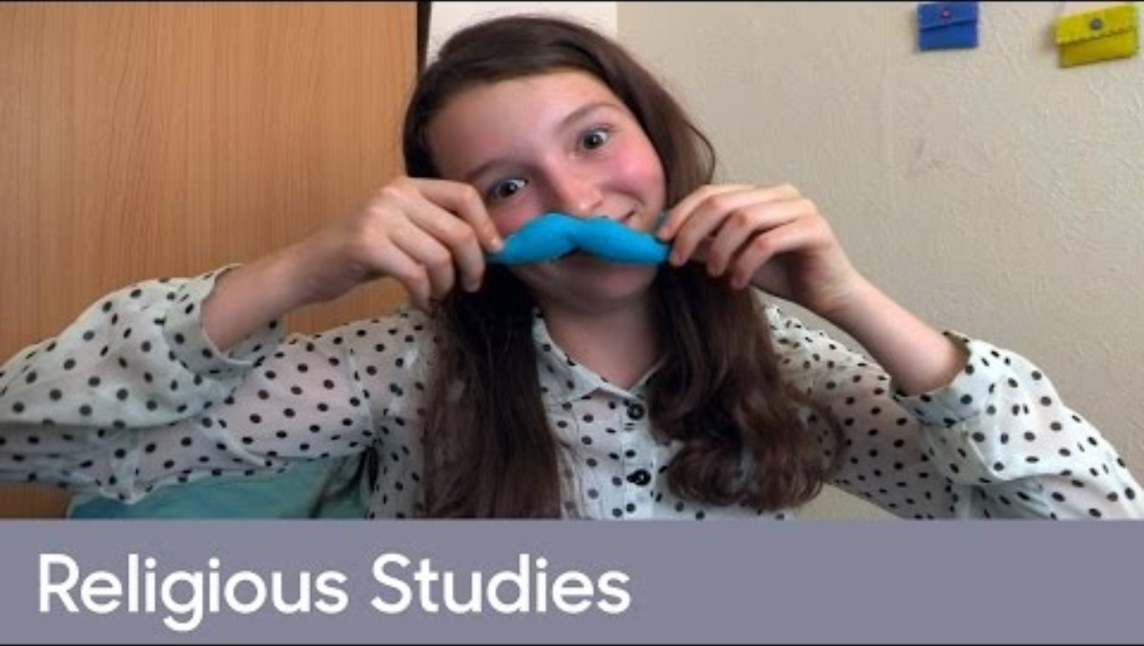
Notes:
This video challenges the stereotyping around Muslims as we meet Sara, an 11 year old Muslim girl. Share this with the children and see if anything surprises them? Can they see any similarities between Christianity and Islam family life? What about differences?

Slide 4
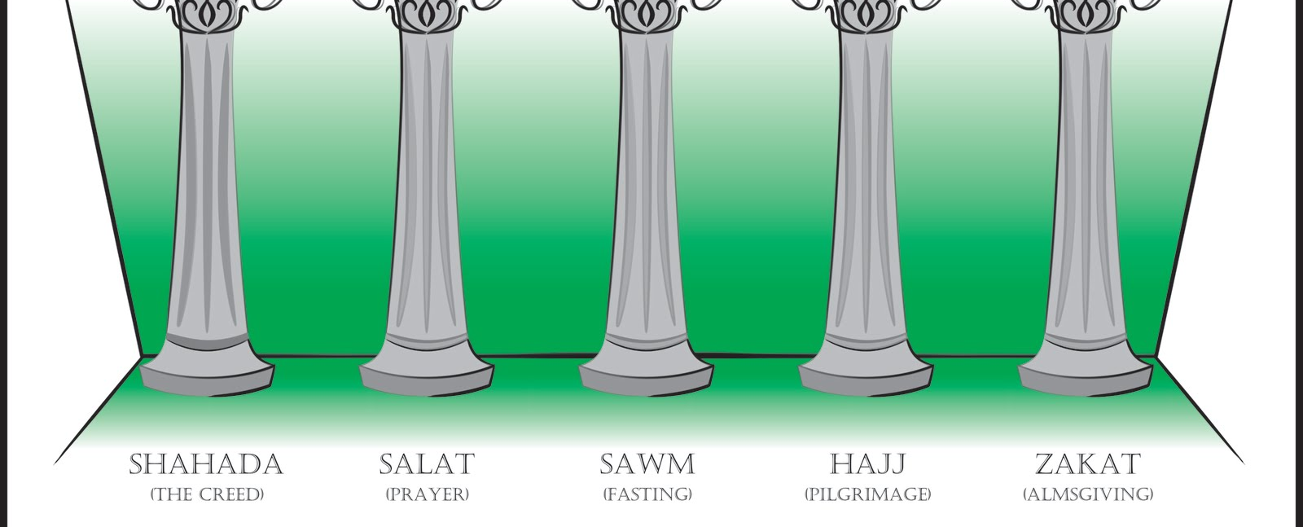
Lessons 2 & 3: WHat is islam?
Notes:
Recap on what you covered in last week's lesson...perhaps rewatch the video of Sara to jog the children's memory. Explain to the children that today we are going to be learning what Islam is and about the importance of the 5 pillars in Islam.

Slide 5
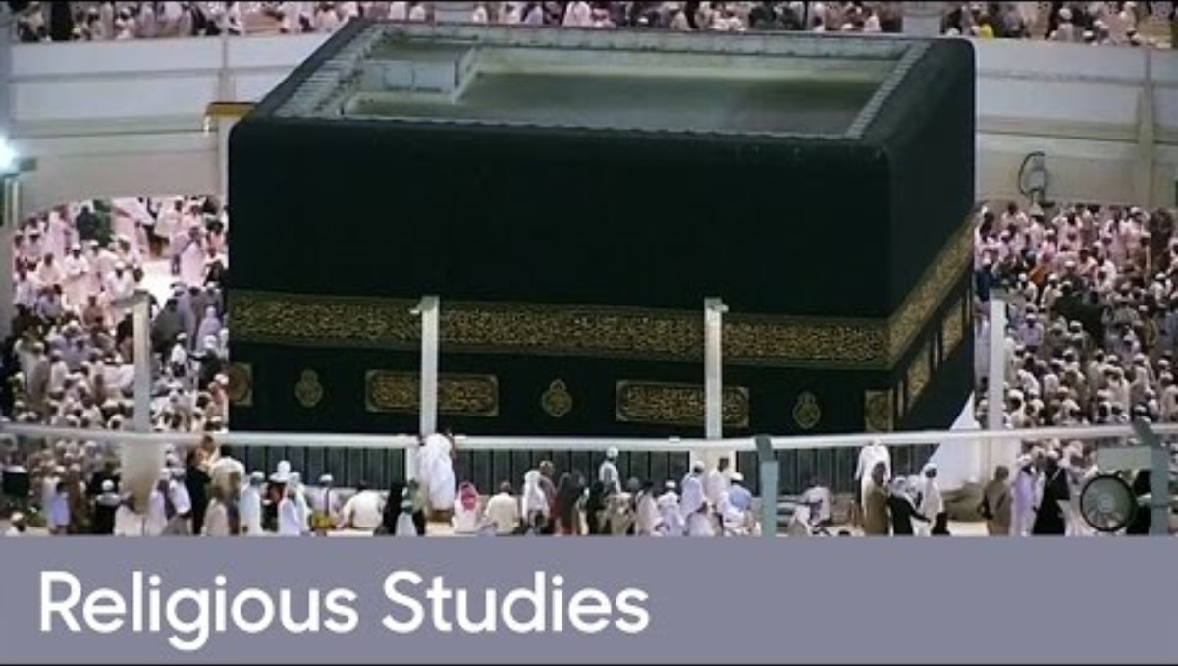
Notes:
This video explains the basics of the 5 pillars through Sara, a young Muslim girl. There is a lot of material to discuss in this video. It might need a couple of lessons for the children to remember a few facts about what is important to Muslims.

Slide 6

Lesson 4: who is allah and what is tawhid?
Notes:
Do you remember from the video last week, what Sara calls God? ALLAH.
Most Muslims believe that Allah is kind, wise, and powerful, and that He listens to their prayers and guides their lives.
There are 99 words for ALLAH in the Muslim holy book, the Ou'ran.
Even though there are 99 names, there is only one God, ALLAH.

Slide 7
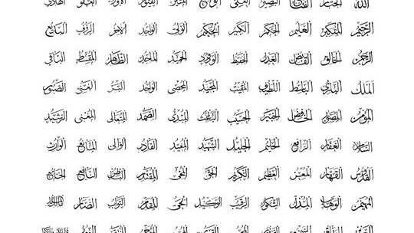
Notes:
Some of the 99 ways of saying Allah – using calligraphy – Talk to the children about these images…can they think of the names they have for themselves

Slide 8
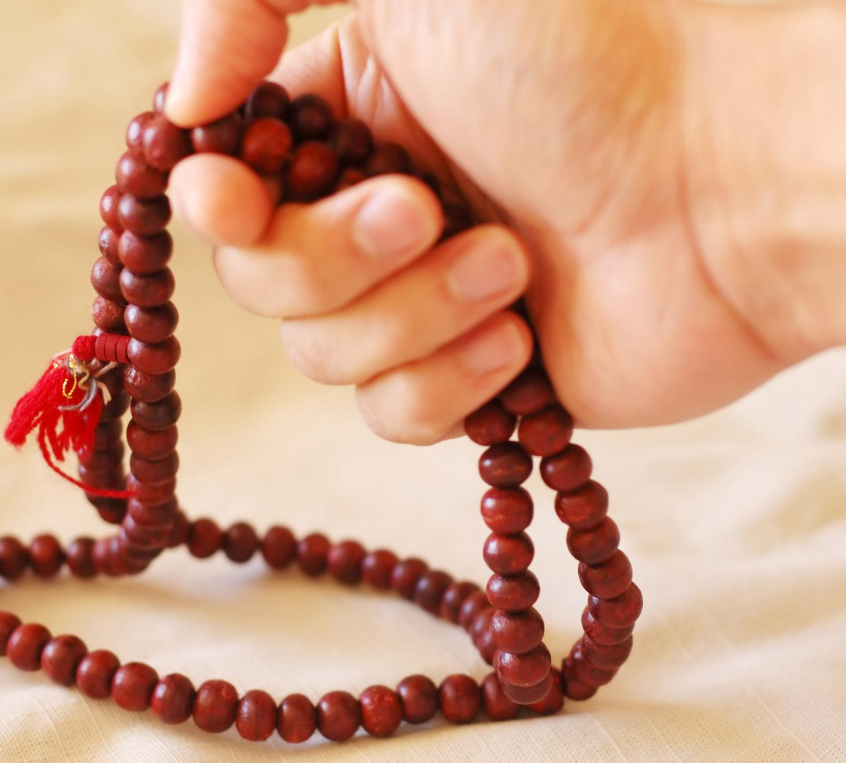
Most muslims believe in one god, allah.
This idea of believing in one god is called tawhid.
Notes:
Most Muslims believe in the concept of Tawhid, the belief in one God, Allah. Most Muslims integrate their beliefs into everyday life, showing how religion can be a guiding force for them if they want it to be...Do you remember the 5 Pillars of Islam and how they help Muslims be good people?
How is the concept of Tawhid, different the Christianity? Link to the Trinity if appropriate...

Slide 9
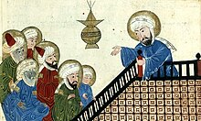
Lesson 5: who is Muhammad (PBUH)?

Slide 10
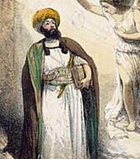
Muhammad (PBUH) is regarded as the prophet or messenger who received divine revelations in Islam.
  He taught people to believe in one God
  Known for kindness, honesty, and bravery, his teachings inspire respect and love among Muslims.
  Muhammad’s (PBUH) example teaches standing up for beliefs and sharing good ideas despite opposition.
Notes:
Muhammad (PBUH) is a central figure in Islam, revered as a prophet and messenger who received 'divine revelations' - special messages - from Allah. He is so special that when Muslims say his name, they say 'Peace Be Upon Him' every time afterwards. They also refer to Jesus in this way. Muhammad (PBUH) lived in a society that believed in many gods, but he taught monotheism—the belief in one God, which in Islam is called Tawhid. He was kind, honest, and brave, and this is why he is respected and loved by Muslims. There are lots of stories about Muhammad (PBUH). Do you know other faiths where there are lots of stories about a particular person? Compare and contrast – recall from prior learning.
One story about Muhammad (PBUH) is about The Night of Power, which is observed during the Muslim festival of Ramadan. It marks the moment when Angel Jibril revealed Allah’s words to Muhammad. This event formed the beginnning of the Qur’an and is celebrated by Muslims through prayer, fasting, and reflection during Ramadan every year.
Here is a link to a story about the Night of Power which you may wish to share with the children: The Night Of Power | Kids Stories about Ramadan | Ramadan for kids videos - YouTube

Slide 11
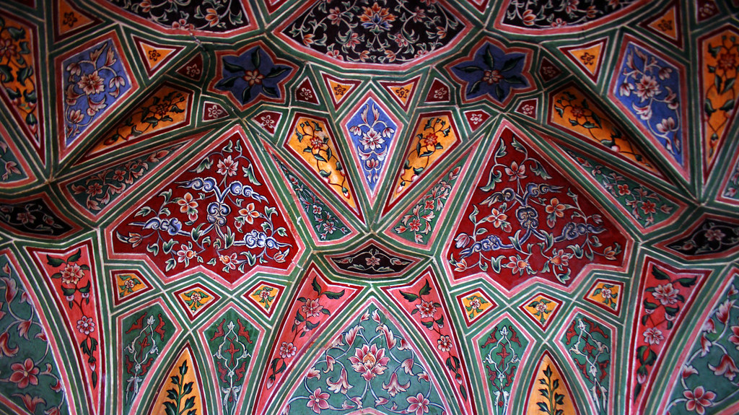
Lesson 6: Recap and Assessment
Notes:
Spend this lesson recapping and making sure the children have the knowledge you want them to have. Revisit the mindmap from the beginning of the unit. What can the children add? What were their favourite things to learn? What is the sticky knowledge and what might you need to revise with them?

