Slide 1
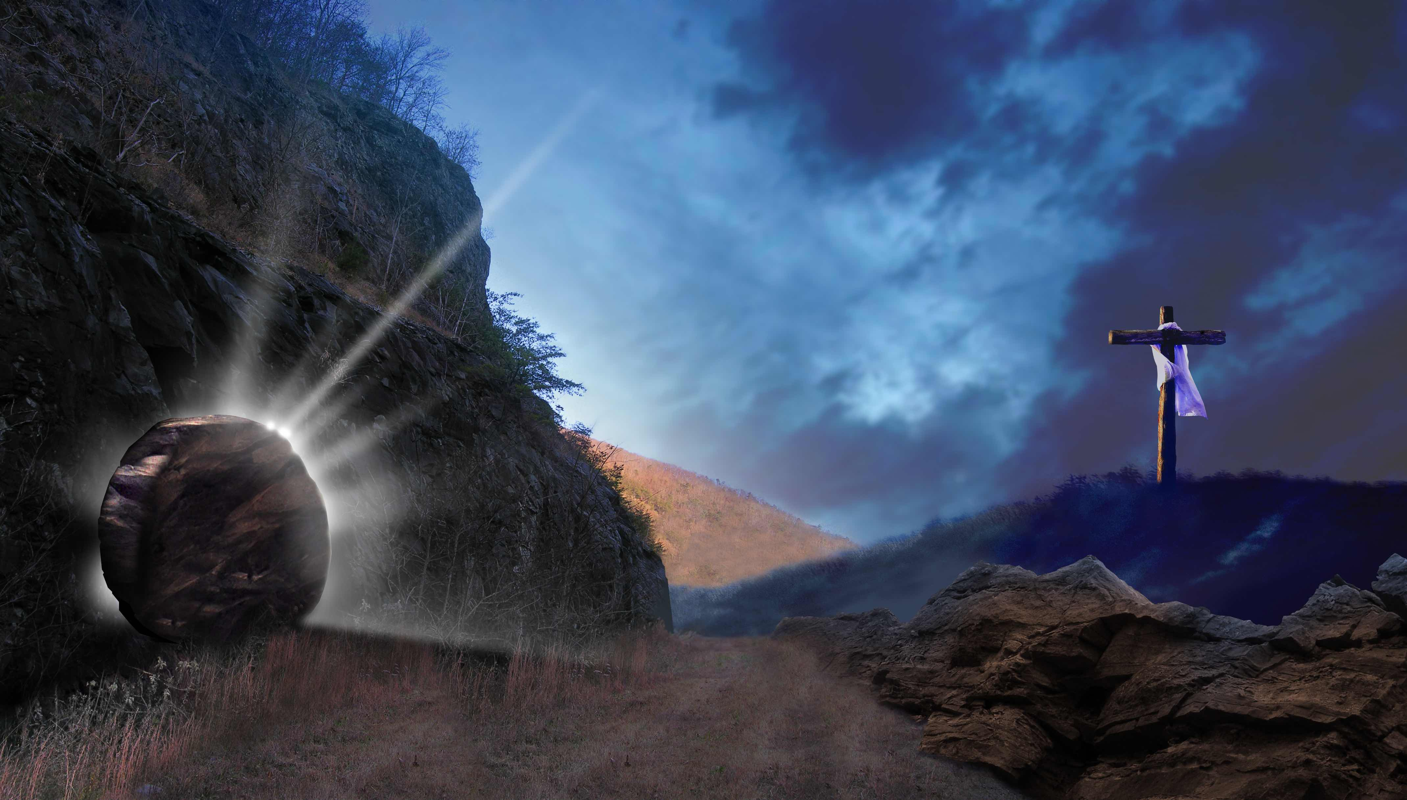
Y6 RE Unit: Christianity – Resurrection
Key Question: How far is belief in the resurrection important to Christians today?

Slide 2
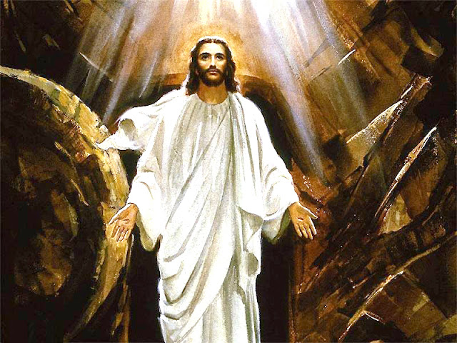
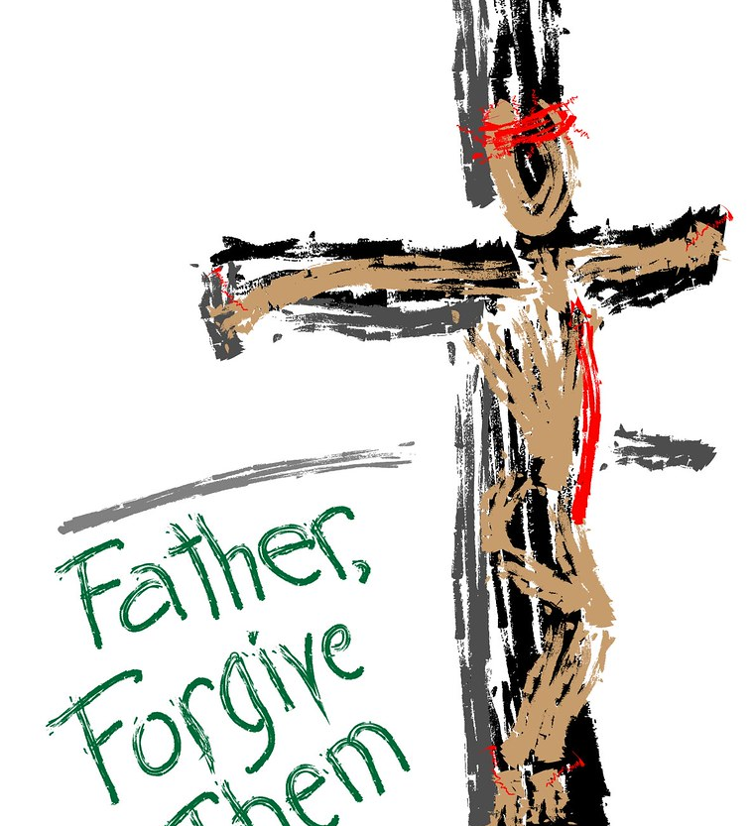
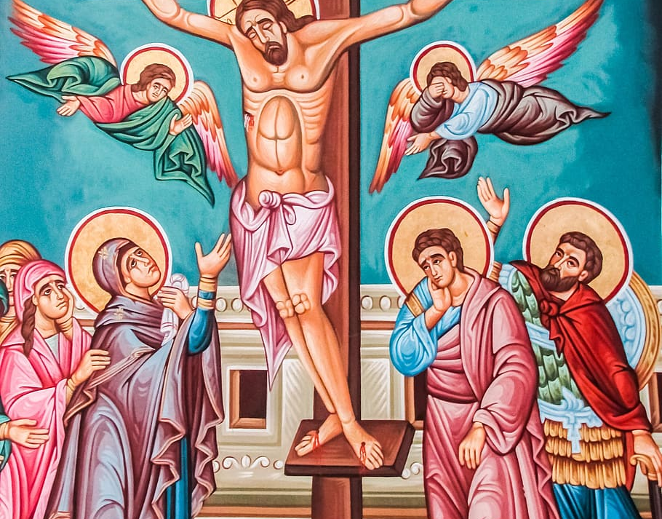
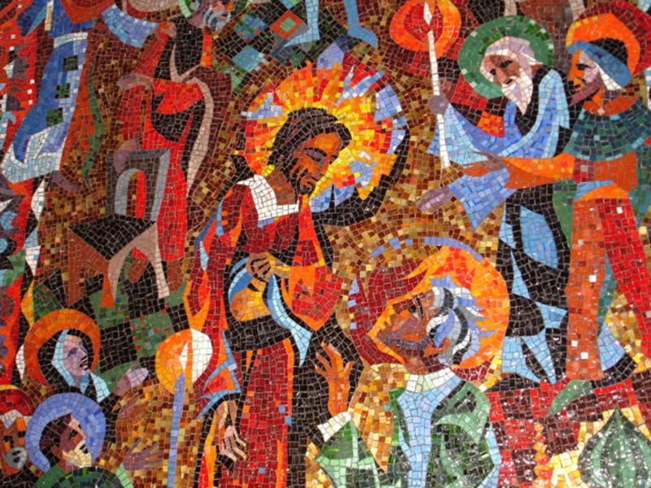
Notes:
Lesson 1: The Easter Story
Ask the children what questions do these pictures inspire?
Use the questions they ask to gauge prior knowledge of the Easter Story.
Can the children remember any of the special language for parts of the Easter Story?
Work with the children to build working definitions of key terms (resurrection, crucifixion, salvation, forgiveness).
Look at different theological accounts of the Easter Story – these are like witness statements taken when police investigate a crime… The four apostles each tell the story…
Matthew 20:19 – Predicts Jesus will be crucified and raised on the third day.
John 20:18 – Mary Magdalene tells the disciples she has seen the risen Lord.
Luke 24:5–6 – Angels inform the women at the tomb that Jesus is not there, but has risen.
Mark 16:6 – A young man at the tomb declares Jesus has risen and shows the empty place.
Matthew 28:6 – Angels tell the women that Jesus has risen, just as he said.
John 11:25 – Jesus declares himself to be the resurrection and the life.
Luke 24:34 – Disciples confirm that the Lord has risen and appeared to Simon.
The Easter Story is a story and stories can be truth or fictitious… and in this term’s unit we are going to explore whether we think this story might be true. Christians believe the story to be true. If you think the story is true, you are not necessarily saying you are Christian. We are going to be using critical thinking skills to decide. We might decide in the end that we are not sure – and that’s ok. We don’t have to tell anyone what we think unless we really want to.
Ask pupils place themselves on a 1–5 scale for how likely/realistic they think resurrection is. They don’t need to share their thoughts, simply record them to see if their ideas change over the course of the unit of work on resurrection.

Slide 3
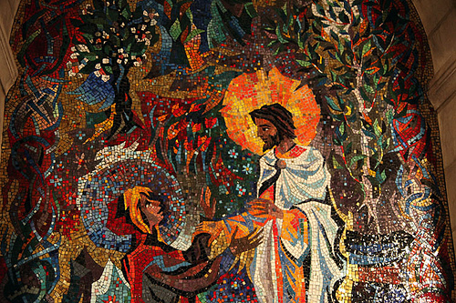
Notes:
Lesson 2: Being detectives and thinking critically
John 20:15–21:14: Resurrection Appearances & Miraculous Catch
John 20:15–18: Jesus appears to Mary Magdalene at the tomb, initially mistaken for a gardener. He tells her not to cling to him because he has not yet ascended and tells her to inform the disciples that he is ascending to his Father.
John 20:19–23: On the evening of the first day of the week, Jesus appears to the disciples, who are locked away in fear of Jewish leaders. He says, "Peace be with you," shows them his hands and side, and breathes the Holy Spirit on them.
John 20:24–29: A week later, Jesus appears again to the disciples, specifically for Thomas (who was absent before), encouraging him to touch his wounds to believe.
John 21:1–14: Jesus appears to disciples fishing at the Sea of Galilee. He directs them to throw their net on the right side, resulting in a massive catch. He then cooks breakfast for them on the shore.

Slide 4
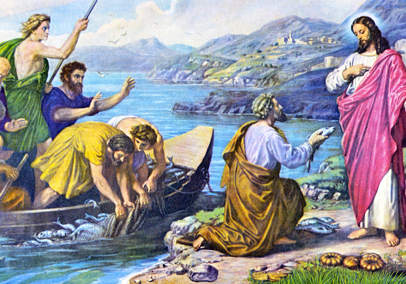
Notes:
Lesson 2: Being detectives and thinking critically (continued)
John 20:24–29: A week later, Jesus appears again to the disciples, specifically for Thomas (who was absent before), encouraging him to touch his wounds to believe.
John 21:1–14: Jesus appears to disciples fishing at the Sea of Galilee. He directs them to throw their net on the right side, resulting in a massive catch. He then cooks breakfast for them on the shore.
Ask the children to think about how they might feel if someone they knew had died and then suddenly appeared before them. Be ready for discussions about ghosts – move away from this and ask the children to imagine that they live in a time before social media, phones and ghosts were even a thing – how does this change how they might actually feel – scared, doubtful, worried, sad, happy – use this as an opportunity to explore difficult feelings and then talk about where we get help from when we go through tough stuff.
Where do Christians get help from when they go through tough stuff? Prayer, God and Jesus are likely responses.
Ask pupils place themselves on a 1–5 scale for how likely/realistic they think resurrection is. They don’t need to share their thoughts, simply record them to see if their ideas change over the course of the unit of work on resurrection.

Slide 5
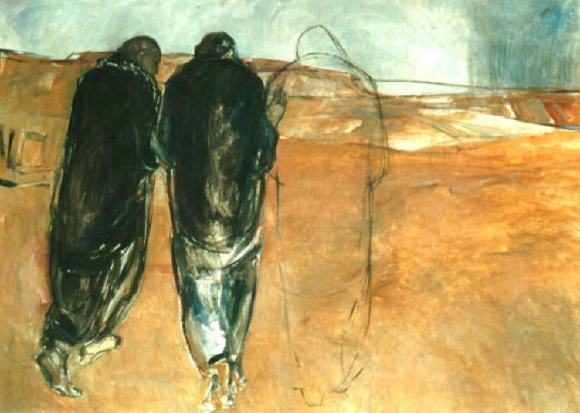
Notes:
Lesson 3: Being detectives and thinking critically (continued)
Luke 24:13–48: The Road to Emmaus & Appearance in Jerusalem
Luke 24:13–35: Two disciples walk to Emmaus, discussing the recent crucifixion. Jesus joins them but is not recognized until he breaks bread with them in the evening. They immediately return to Jerusalem to tell the others.
Read the story of the Road to Emmaus to the children

Slide 6
Notes:
Lesson 3: Being detectives and thinking critically (continued)
Luke 24:13–48: The Road to Emmaus & Appearance in Jerusalem
Luke 24:36–43: While the two recount their story, Jesus stands among the disciples, reassuring them he is not a ghost by showing his hands and feet, and eating broiled fish in their presence.
Luke 24:44–48: Jesus explains how the Law of Moses, the Prophets, and the Psalms predicted his suffering and resurrection, declaring them witnesses to these events.
How might these eye-witness accounts add to their evidence about the truth of the resurrection?
Ask pupils place themselves on a 1–5 scale for how likely/realistic they think resurrection is. They don’t need to share their thoughts, simply record them to see if their ideas change over the course of the unit of work on resurrection.

Slide 7
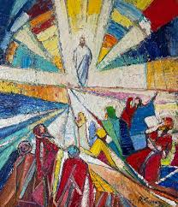
Notes:
Lesson 4: Debate about the resurrection
Start with a silent debate. Show them the picture above and ask them to respond to the picture however they would like to, with an action, by writing a few words on a post-it, or a short mime.
Say that you are going to show them a few pictures to get them thinking – how do they respond to these pictures?

Slide 8
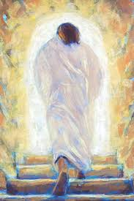
Notes:
Lesson 4: Debate about the resurrection
Picture No 2

Slide 9

Notes:
Lesson 4: Debate about the resurrection
Picture No 3

Slide 10
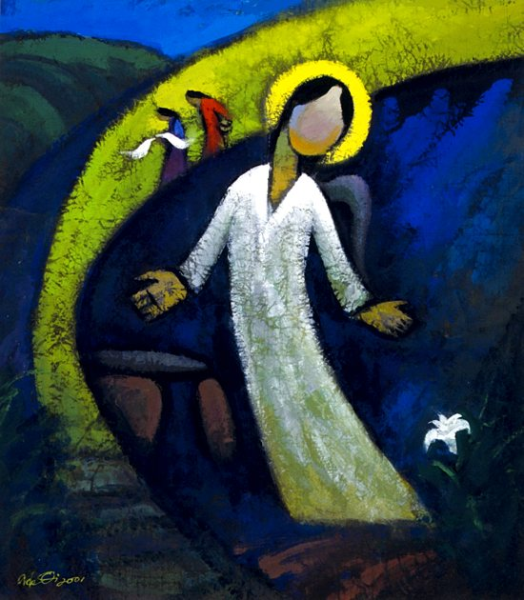
Notes:
Lesson 4: Debate about the resurrection
Picture No 4

Slide 11
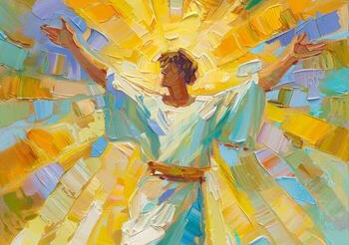
Notes:
Lesson 4: Debate about the resurrection
Picture No 5
Has responding to these images changed your view of the Easter Story? If so, how?
If the story happened nearly 2000 years ago, why do we think there are still people creating artwork about it?
Christians believe that the story is true. How far is belief in the story important to Christians? Where would most Christians be on a scale of 1-5 do you think? Is that all Christians, many, most or some?
Ask pupils place themselves on a 1–5 scale for how likely/realistic they think resurrection is. They don’t need to share their thoughts, simply record them to see if their ideas change over the course of the unit of work on resurrection.

Slide 12
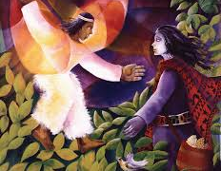
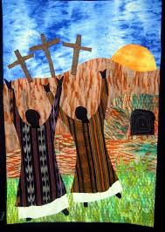
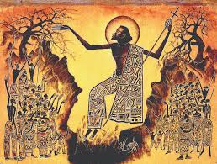
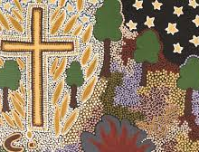
Notes:
Lesson 5: Exploring Christian approaches to eternal life
Here is some artwork from around the world which expresses why the resurrection is important for Christians around the globe.
What questions do you have about what Christians believe about eternal life?
Christian belief in life after death - Life after death - CCEA - GCSE Religious Studies Revision - CCEA - BBC Bitesize
KS2 Religious Studies: Easter - BBC Teach – this is a useful video to show how two Christian children celebrate Easter in the Liverpool and Jerusalem

Slide 13
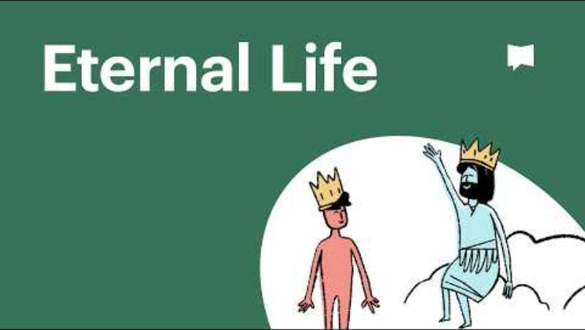
Notes:
Lesson 5: Exploring Christian approaches to eternal life
This is a child friendly video – but you may need to watch it a couple of times to understand it as it is quite complex…you may wish to link to Dr Strange and the multiverse (!) to support the children to understand the concept more easily – it is a very abstract concept so don’t worry too much if it is not understood by all. It is meant to provoke thinking and more questions rather than give answers!
How do Christians try to live their lives in order to get eternal life?

Slide 14
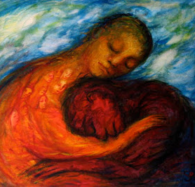
Notes:
Lesson 6: Lived Faith – Holy Spirit and Courage
Look at this picture carefully – what can you see? Who do you think it is in the picture? What do you think it means?
How might a Christian answer these questions?
Christians believe that Jesus died on the cross so that they can be saved – what do you think they need saving from?
Forgiveness – who needs it?
Sharon borrowed her friend Daisy’s new iPad for the afternoon, with permission of course, but her little brother, running round, trod on it. The iPad still works, but it has a big scratch on the front. ‘I’m really sorry, Daisy,’ says Sharon, ‘it was an accident. I half killed David. Please can you forgive me?’ Daisy looked at the long scratch on the iPad. It had been all shiny before. What should Daisy say next?
Is being saved the same as being forgiven?

Slide 15

Notes:
Lesson 6: Lived Faith – Holy Spirit and Courage
It can take courage to forgive a person who has hurt you. Christians believe that the get that courage from believing in Jesus and that they call on the Holy Spirit to help them. The Holy Spirit is often represented by a dove - why do you think that is?
How might this image be important to a Christian?
A dove often represents freedom and for Christians, the symbol of the cross represents the resurrection, freedom, being saved from sin and the promise of eternal life…
So, how far is belief in the resurrection important to Christians today? I asked you at the beginning of this term to decide on a 1–5 scale for how likely/realistic you think resurrection is. How much on a scale of 1-5 do you think that the resurrection is important for Christians today? Would a Christian agree with your answer?

