Slide 1
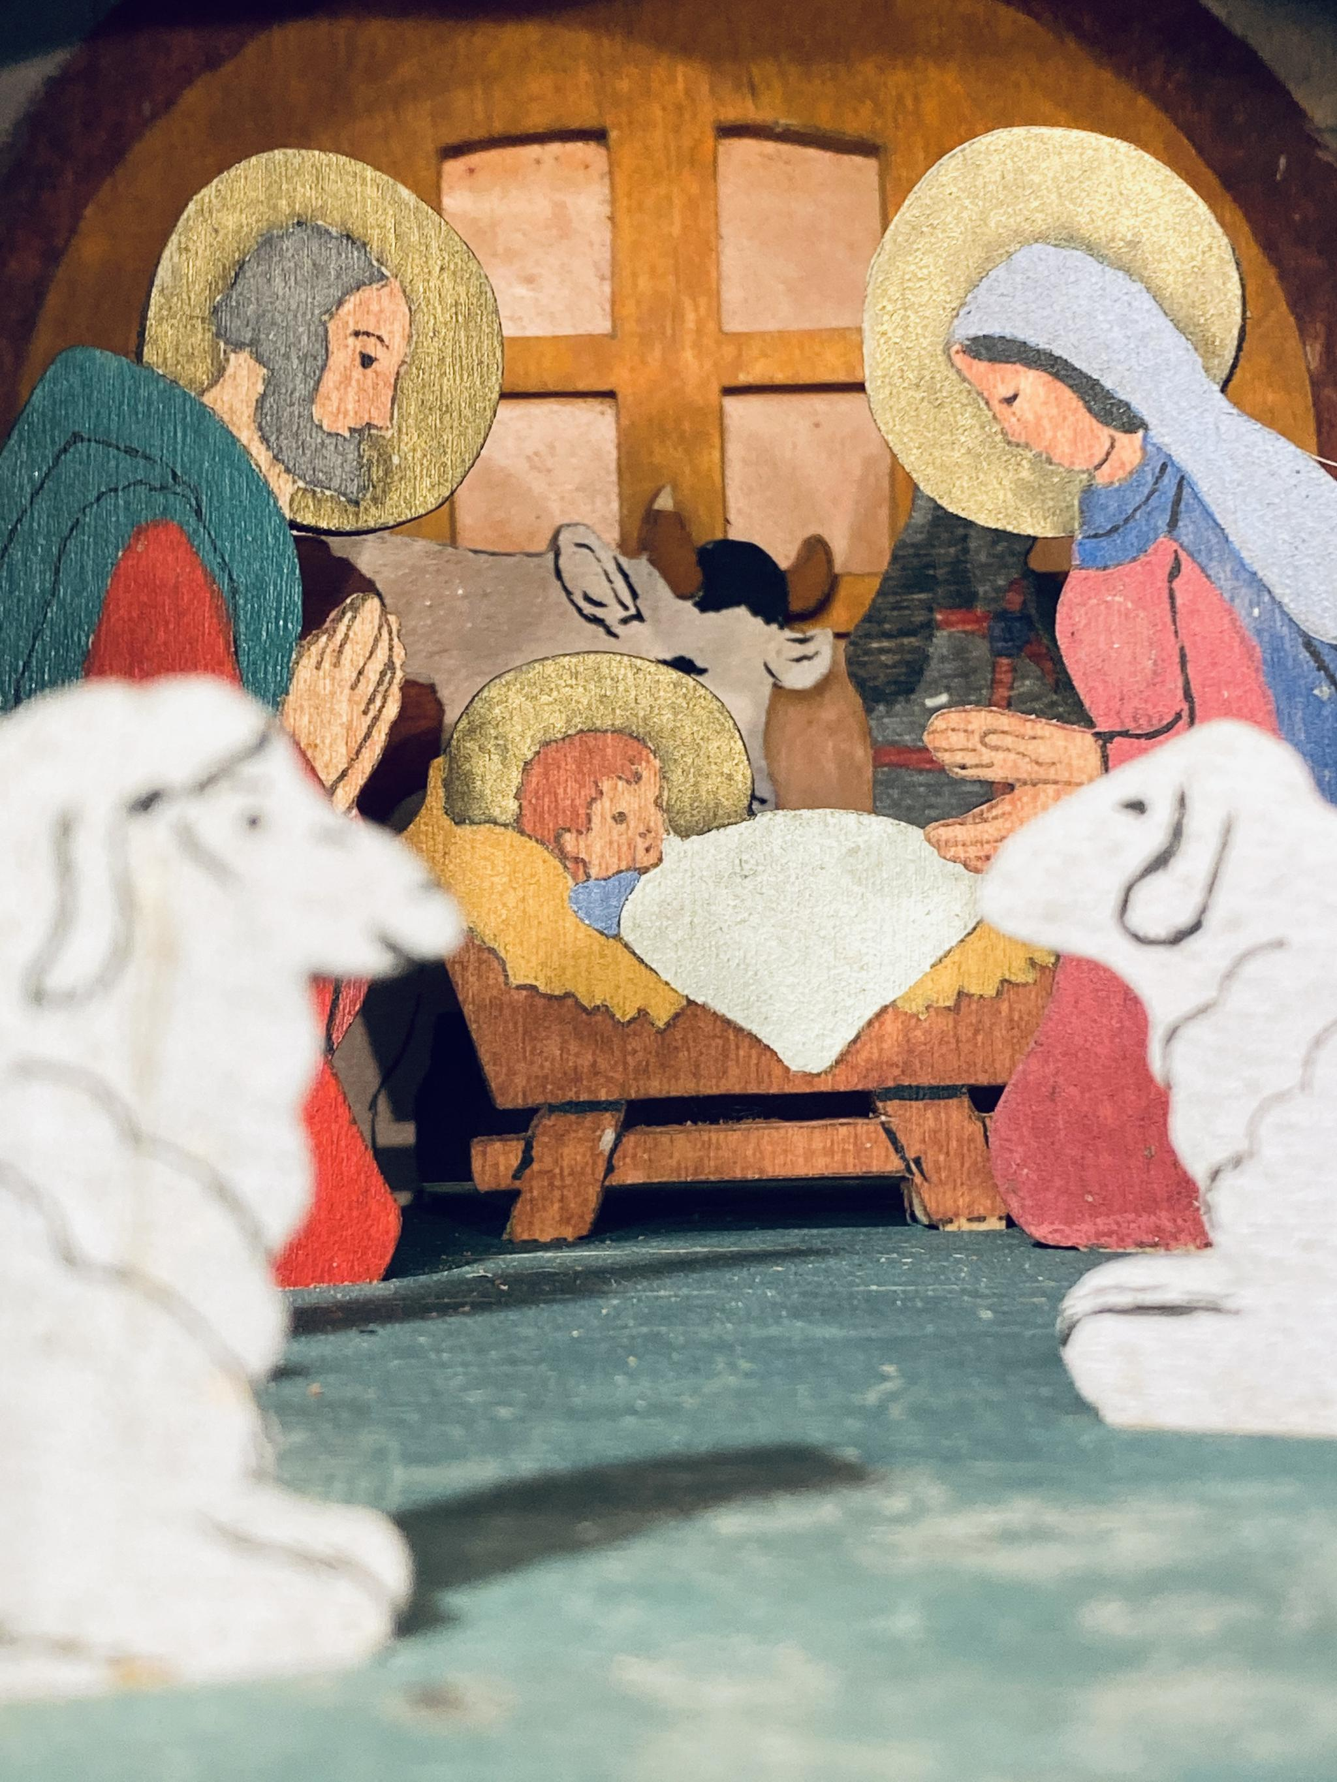
What do most Christians celebrate together?

Slide 2
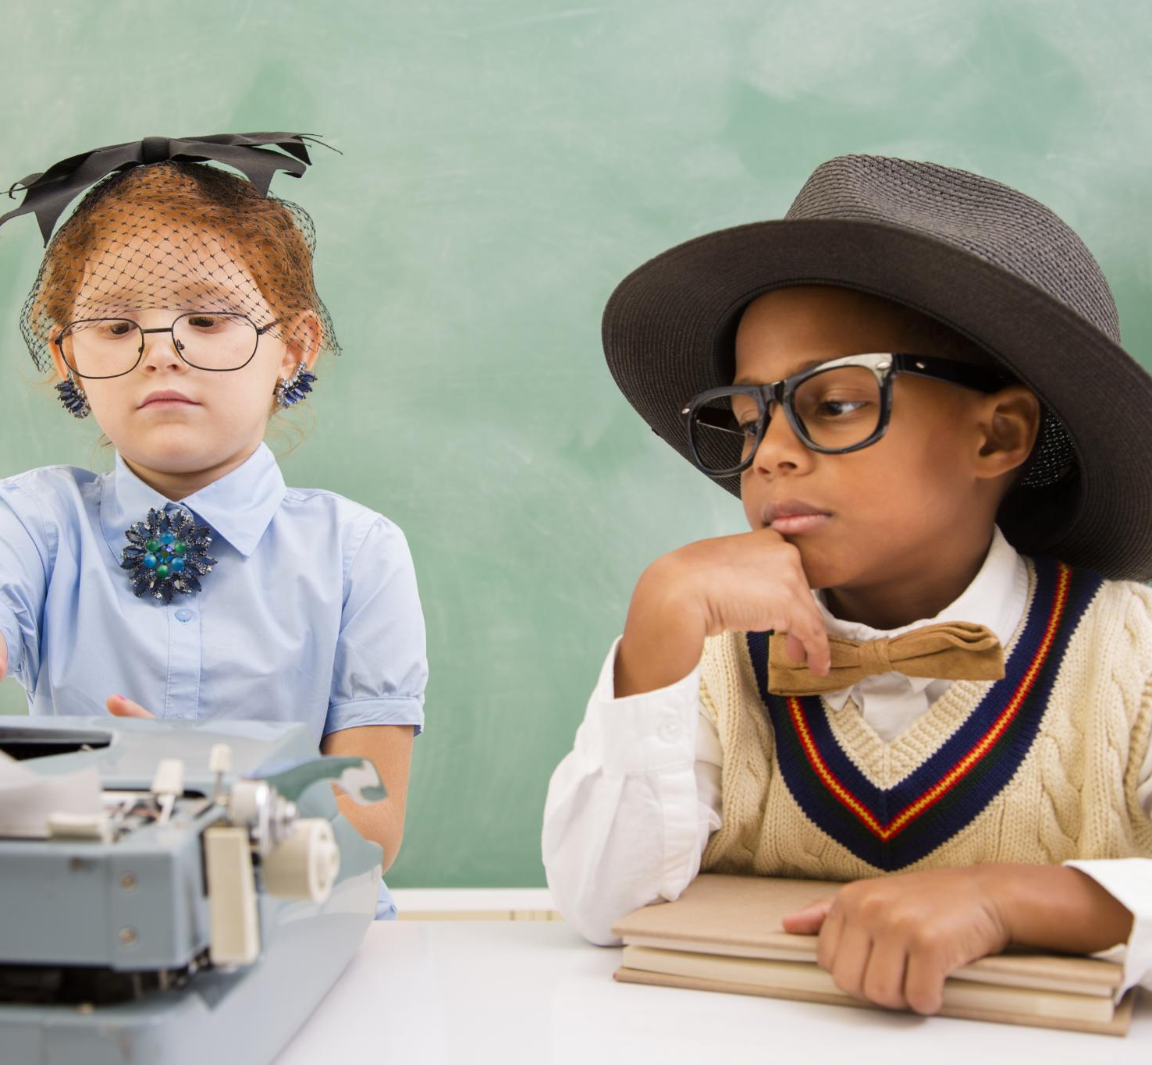
We Are Detectives!
Notes:
Today, we are all detectives! That means we are going to look for clues and find out interesting things about baby Jesus and what happened when he was born.

Slide 3
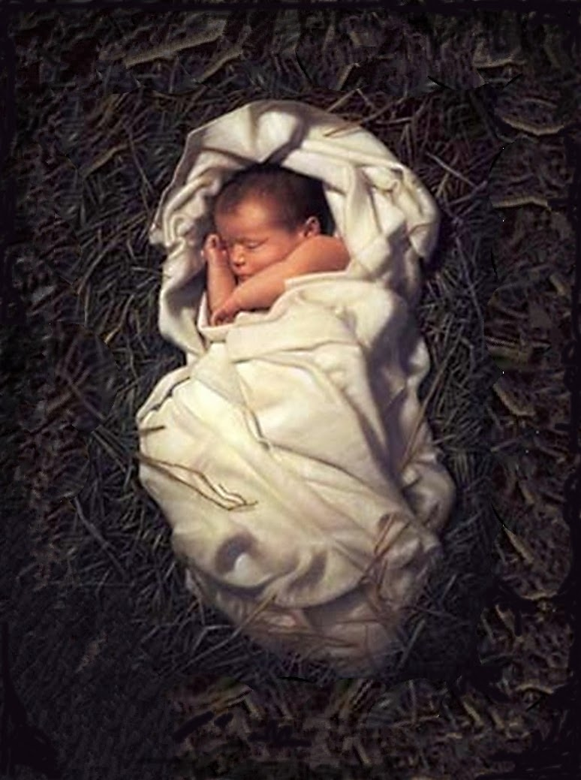
Who Was Baby Jesus?
ThePhoto by PhotoAuthor is licensed under CCYYSA.
Notes:
Ask the children what they know already.

Slide 4
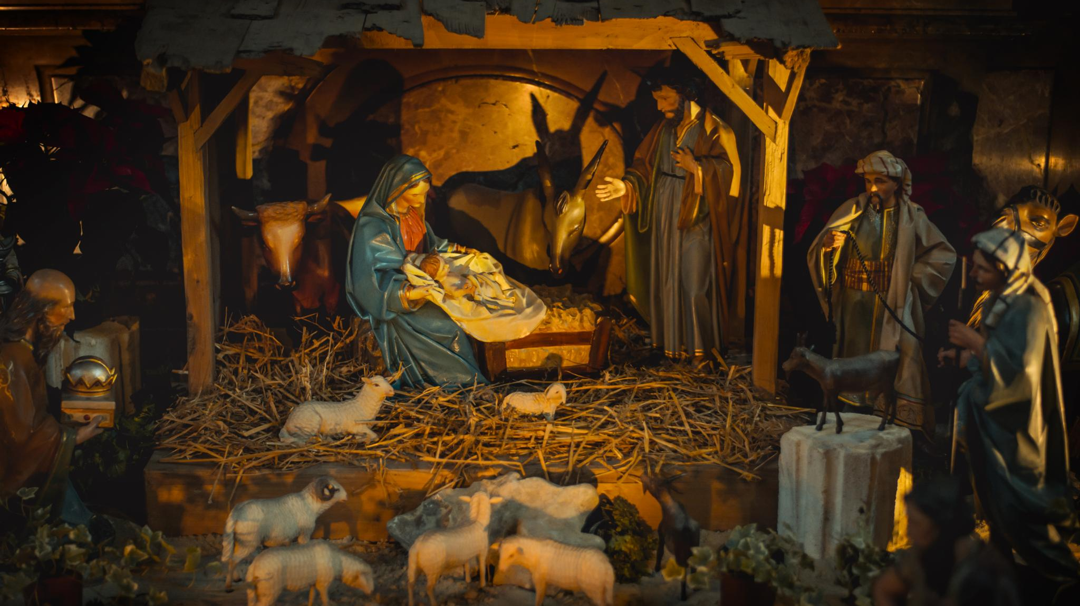
Notes:
What does this picture tell us about when and where Jesus was born?
Do you know when and where you were born?
Put your detective hat on...what are the differences between you and Baby Jesus?
What might have been the same?
What do we call the special time when Baby Jesus was born?
How do you celebrate Christmas? Maybe you don't celebrate Christmas in your house...what do you do instead?

Slide 5
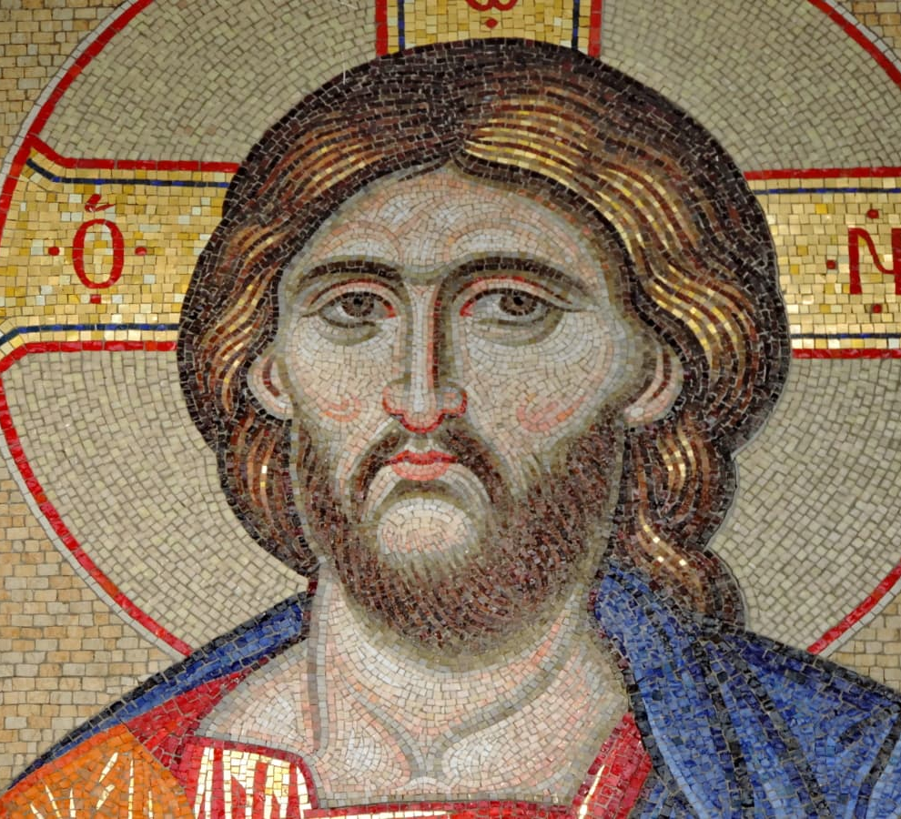
A picture of what Jesus might have looked like when he grew up.
Notes:
Christians are people who think that Jesus was a very special person.

Slide 6

Notes:
Most Christians celebrate Christmas when they remember when Jesus was born

Slide 7
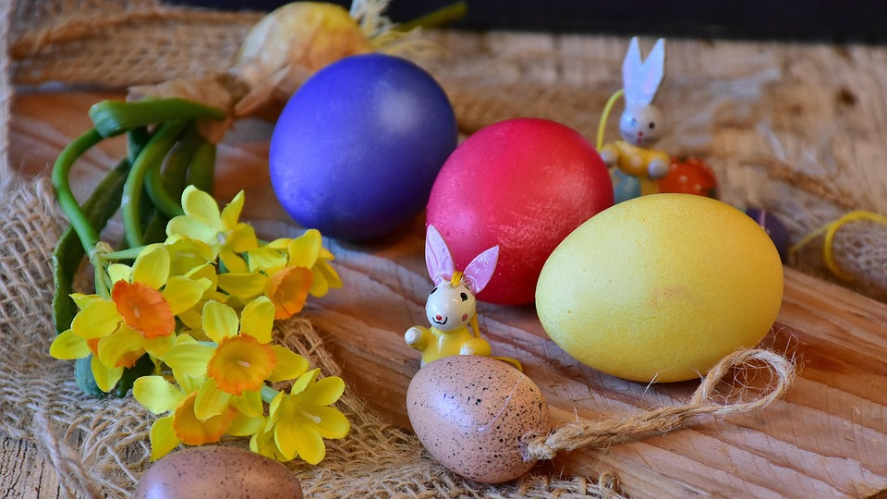
Notes:
Many Christians celebrate Easter when they think about how Jesus died.

Slide 8
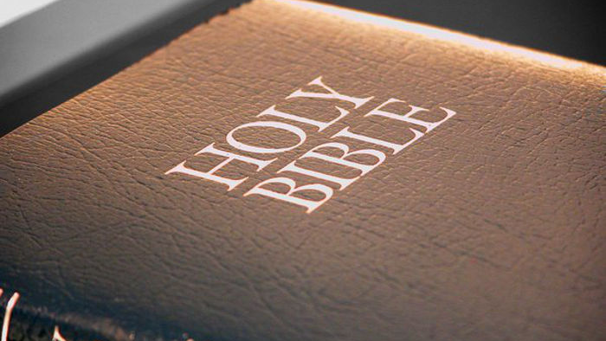
Notes:
There are lots of stories written about Jesus and these are in the Bible. The Bible is a very special book which was written by people who lived a very long time ago.

Slide 9
We Are Detectives!
Notes:
Today, we are all detectives! We are going to look at lots of different versions of the Bible and see what we notice about them.

Slide 10
Notes:
Recap the slides from the last two lessons
Jesus was a very special baby. He was born in a town called Bethlehem. His mummy's name was Mary, and his daddy's name was Joseph. They loved Jesus very much and took care of him. Jesus was born in a simple place, a stable, where animals lived. Even though it was not a fancy place, it was filled with love and happiness because Jesus was there. Many people were excited about his birth, and soon, visitors would come to see him. Let's keep looking for more clues about Jesus' birth!

Slide 11
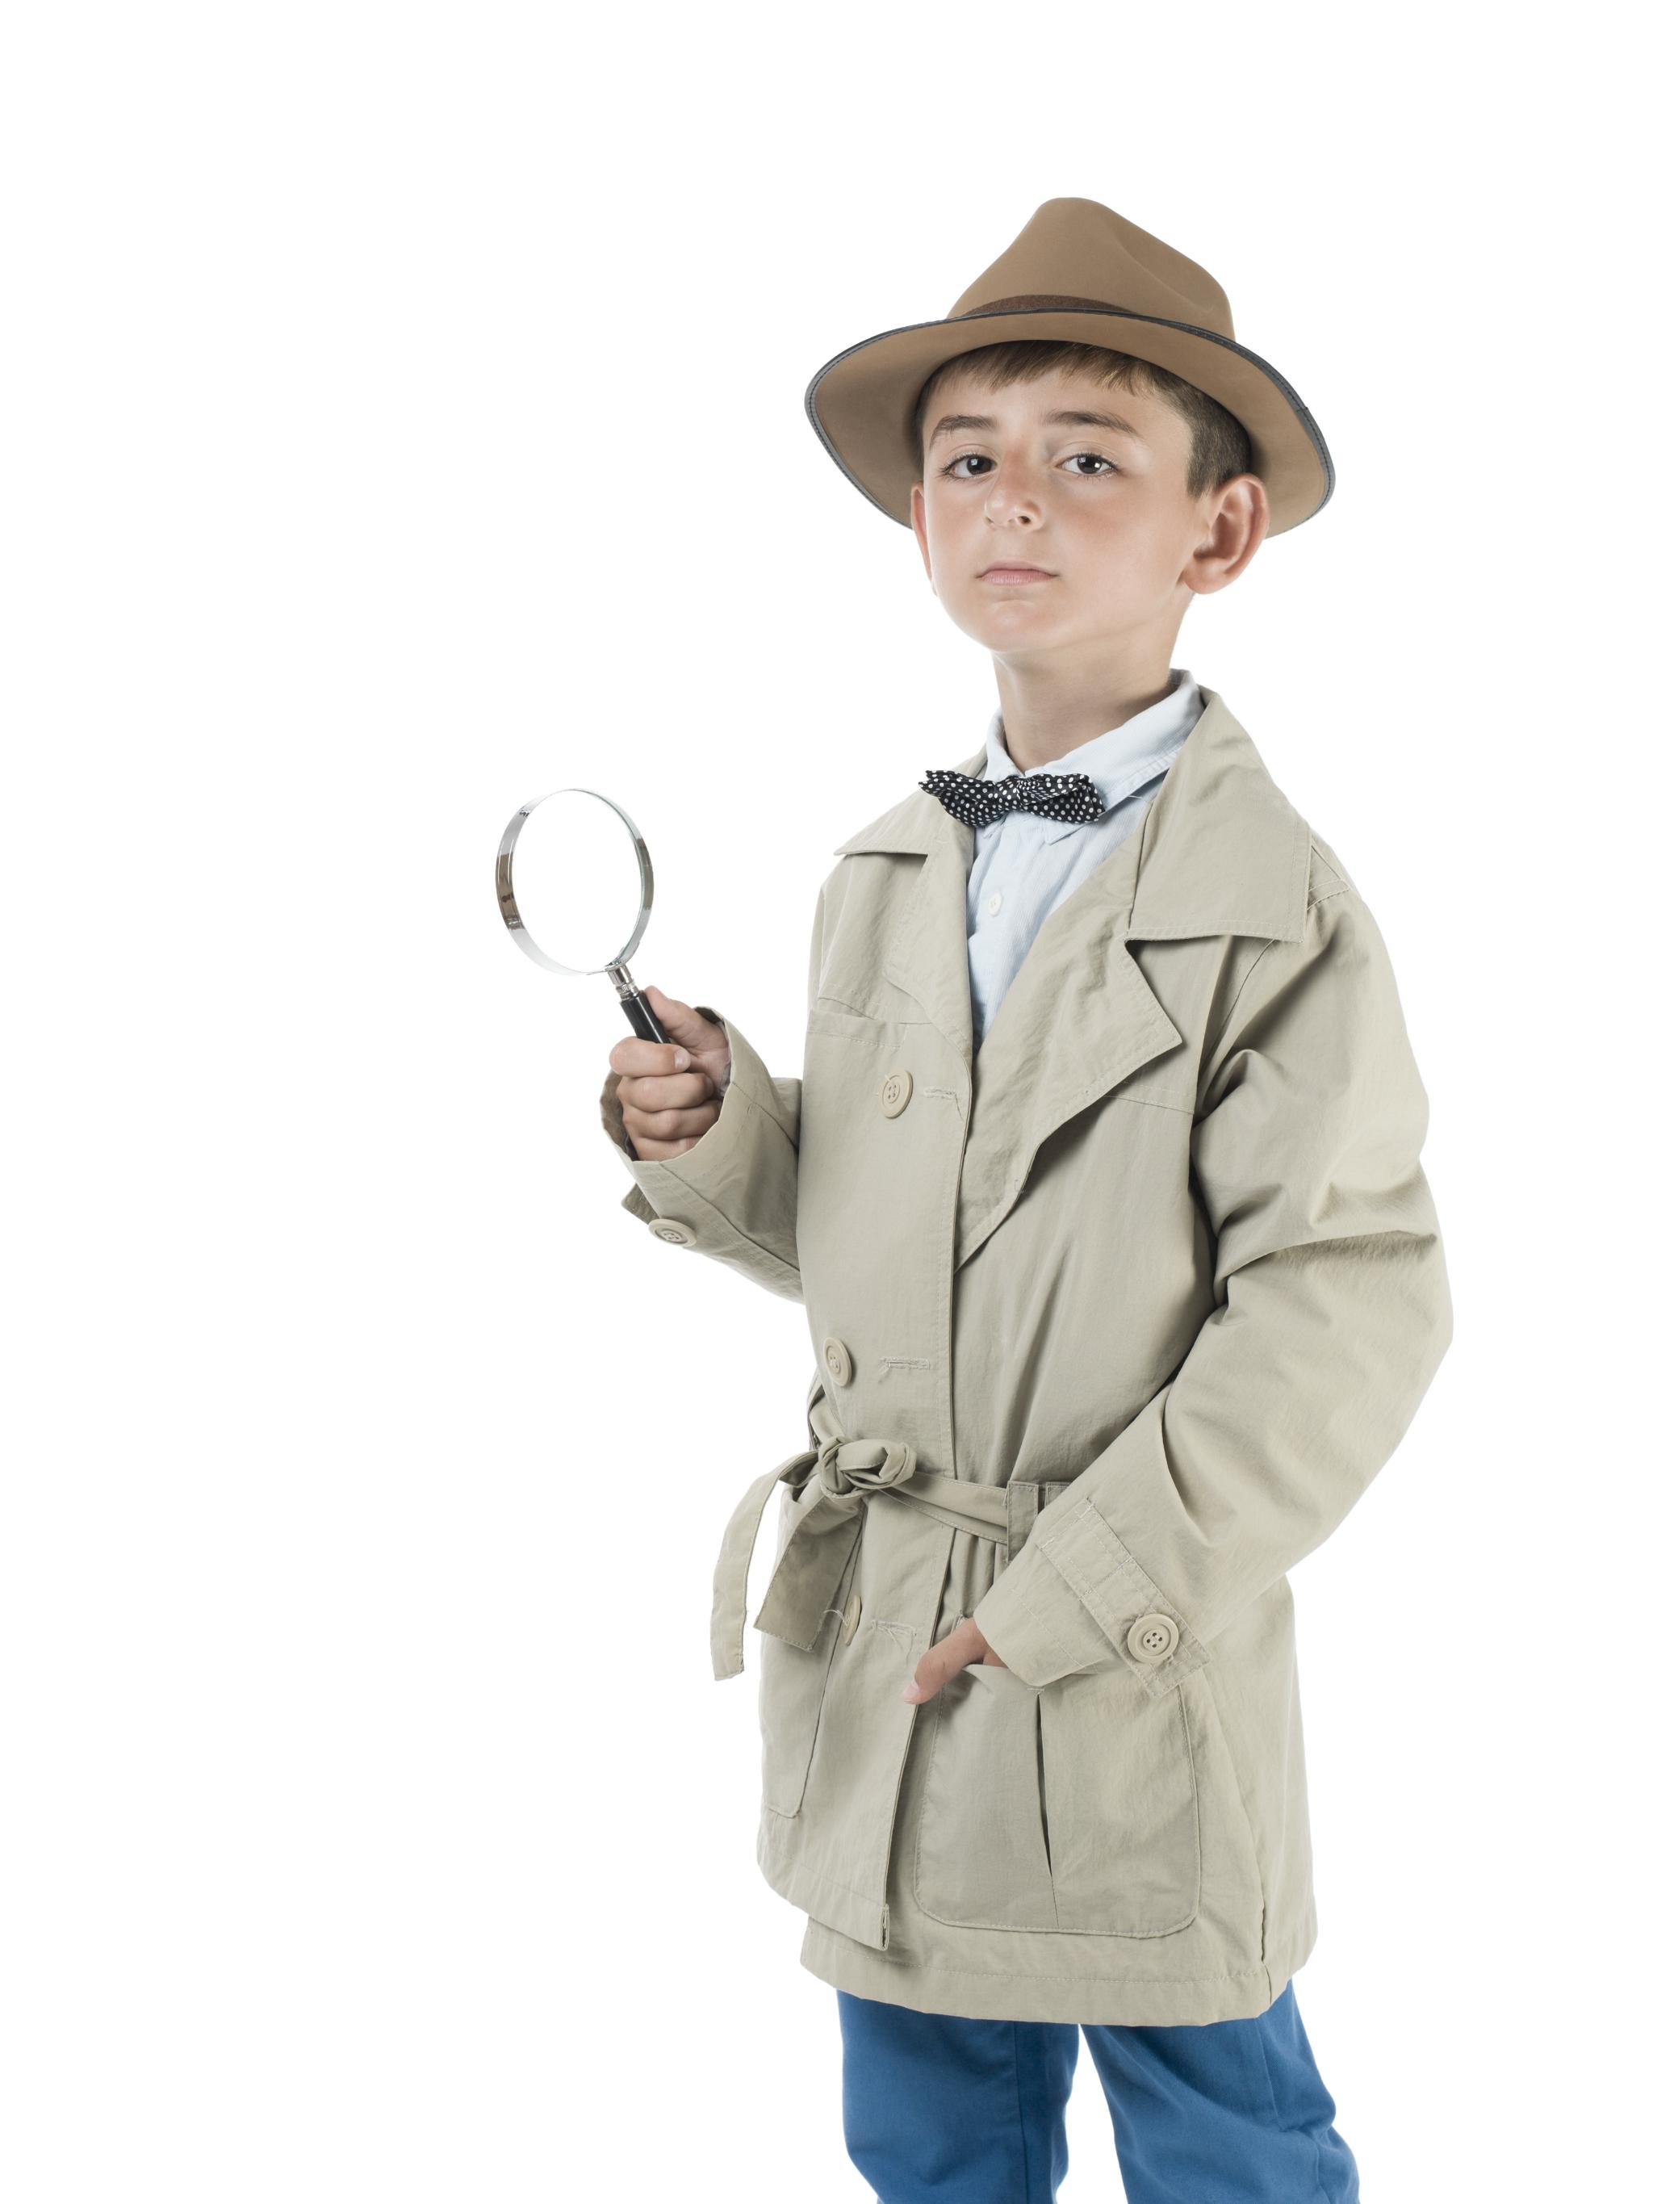
Detective Time!
Notes:
We will read two stories from the Bible and see what they tell us about Jesus' birth. As detectives, we will pay close attention to the details, ask questions, and share what we notice. Let's begin our detective adventure with the first story!

Slide 12
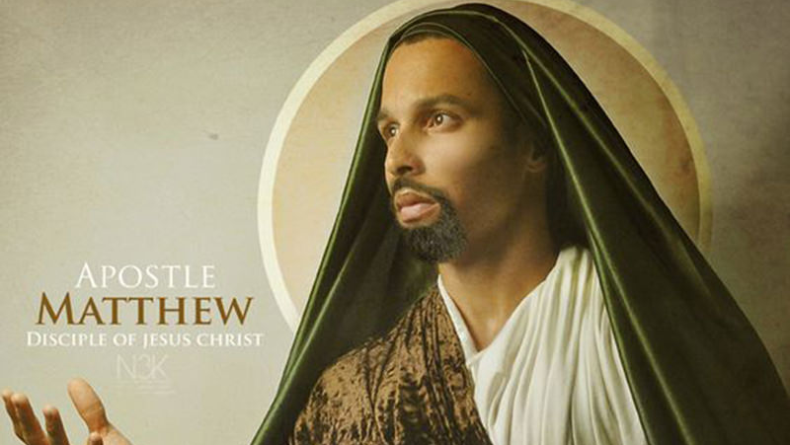
Notes:
This is a picture of what Matthew might have looked like. Matthew was one of Jesus' special friends. He wrote a story about Jesus being born. This is the story that Matthew wrote:

Slide 13
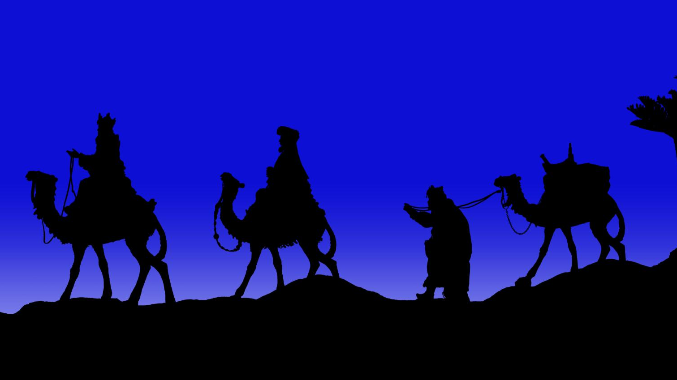
Notes:
The Story of Baby Jesus (Matthew’s Story)
A long time ago, there was a kind lady named Mary and a good man named Joseph.
Mary was going to have a special baby. An angel came to Joseph and said,
“Don’t be afraid. Mary’s baby is from God. You will call him Jesus.”
Mary and Joseph went on a long journey to a town called Bethlehem.
When they got there, it was very busy and there were no rooms left.
So, Mary and Joseph stayed in a stable, where animals sleep.
That night, baby Jesus was born!
Mary wrapped him up and laid him in a manger, a little bed of hay.
Far away, some wise men saw a bright star in the sky.
The star showed them that a special baby had been born.
The wise men followed the star all the way to Jesus.
When they found Jesus, the wise men were so happy!
They gave him special gifts: gold, frankincense, and myrrh.
Everyone was glad that baby Jesus was born

Slide 14
Detective Time!
Notes:
What did we notice about Matthew's story of Jesus being born?

Slide 15
Detective Time!
Notes:
We will read two stories from the Bible and see what they tell us about Jesus' birth. As detectives, we will pay close attention to the details, ask questions, and share what we notice. Let's begin our detective adventure! Here is the second story.

Slide 16
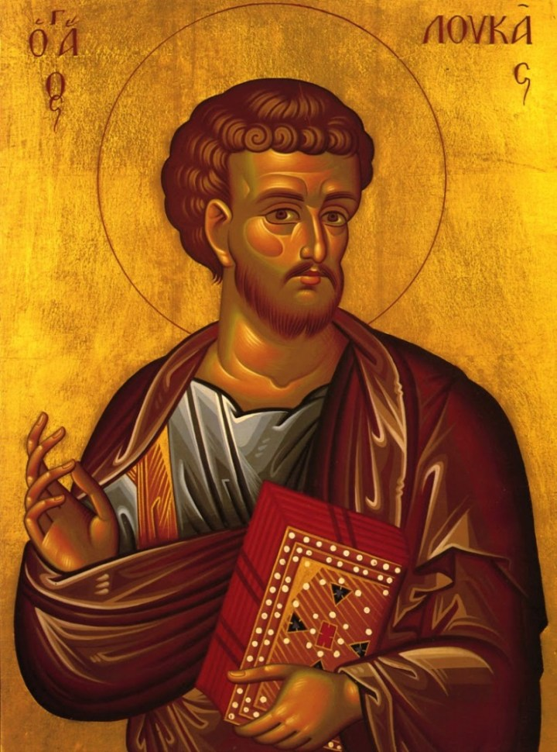
Notes:
This is a picture of what Luke might have looked like. Luke was also one of Jesus' special friends. He also wrote a story about Jesus being born. This is the story that Luke wrote:

Slide 17
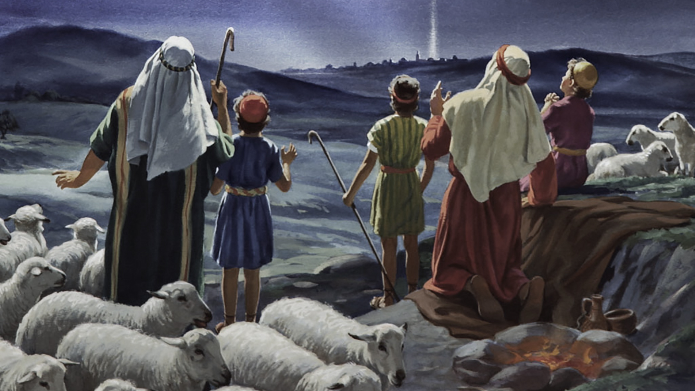
Notes:
The Story of Baby Jesus (Luke’s Story)
A long time ago, Mary and Joseph had to travel to a town called Bethlehem.
Mary was going to have a special baby from God.
When they got to Bethlehem, there were no rooms left for them to stay.
So, Mary and Joseph stayed in a stable, where animals sleep.
That night, baby Jesus was born!
Mary wrapped him up and laid him in a manger, a little bed of hay.
Out in the fields, some shepherds were looking after their sheep.
Suddenly, an angel appeared! The angel said,
“Don’t be afraid! I have good news. A special baby has been born. His name is Jesus!”
More angels appeared and sang happy songs.
The shepherds hurried to see baby Jesus.
They found him lying in the manger, just like the angel said.
The shepherds were so happy! They told everyone the good news:
Jesus was born!

Slide 18
Detective Time!
Notes:
It's time to use our detective skills! Let's think about what we saw and heard in the stories. What was the same in both stories? What was different? Who came to visit baby Jesus?

Slide 19
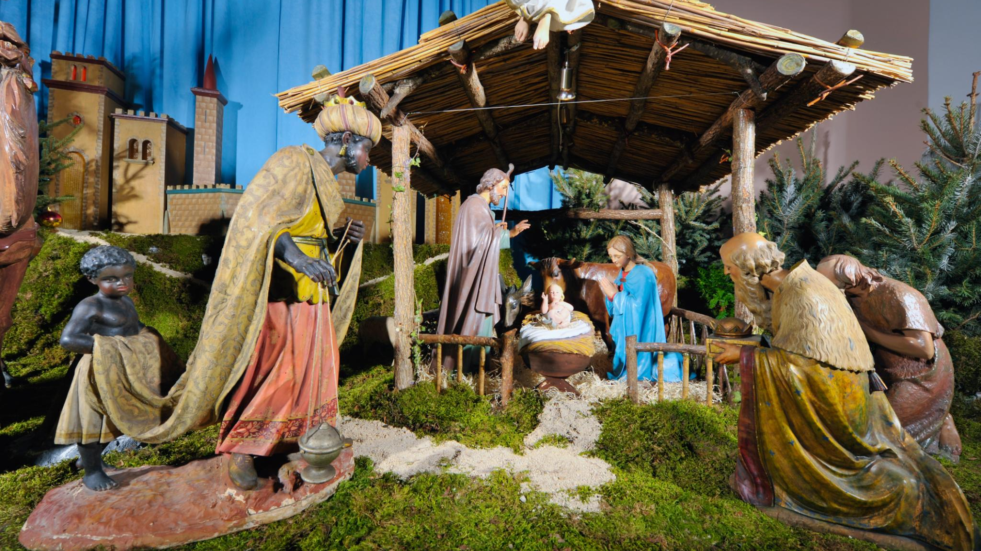
Notes:
Both stories in the Bible tell us some things that are the same about Jesus' birth. Jesus was born in Bethlehem, and his parents were Mary and Joseph. He was a very special baby, and people came to visit him after he was born. These visitors were excited to see Jesus and brought gifts or shared happy news. Both stories show us that Jesus was loved and cared for by his family and by the people who came to see him. No matter which story we read, we learn that Jesus' birth was a joyful and important event.

Slide 20
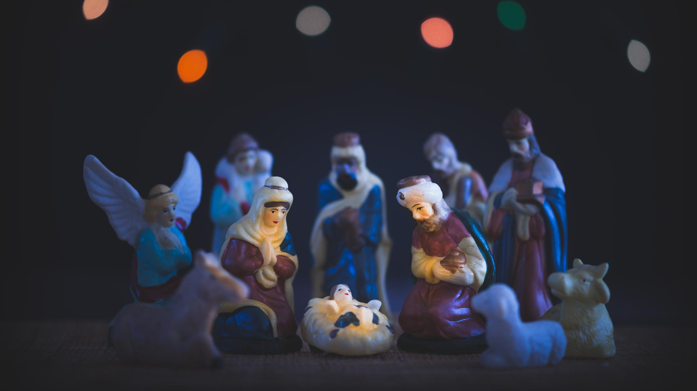
Notes:
Even though the stories are similar, there are also some differences. In Matthew's story, an angel talks to Joseph and tells him about Jesus. Wise men, sometimes called Magi, come to visit Jesus and bring him special gifts. Matthew's story calls Jesus the King! In Luke's story, an angel talks to Mary and tells her she will have a special baby. Shepherds, who take care of sheep, come to visit Jesus after angels tell them the good news. Luke's story calls Jesus the Saviour! Saviour means someone who saves people. These differences help us see that Jesus was important to many different people, and everyone was excited about his birth.

Slide 21
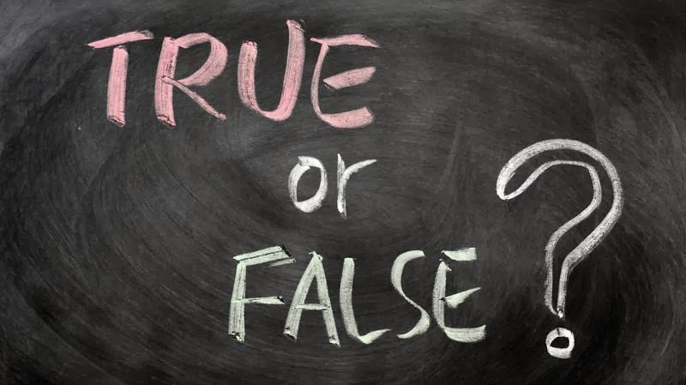
Notes:
Recap the stories / previous slides
Stories can be true, or not true, or a mixture of both – detectives try to find out the truth about something that has happened. Finding out the truth about something that has happened means talking to people and looking at information. Then sometimes we need to make up or own minds about what is true or not.
Play true or false – no right or wrong answer...
What do you think is true about when Jesus was born?
Do you think he was born in a stable?
Do you think the wise men arrived first?
Do you think the shepherds saw some angels?
Now it's time to draw! Take a piece of paper and draw a picture of what you think happened when baby Jesus was born. You can also draw the people who came to visit him. Was it the wise men, the shepherds, or both? Use lots of colors and make your picture bright and happy. When you are finished, you can show your drawing to the class and talk about who you drew and why. Drawing helps us remember the story and share what we learned.

