Slide 1
Seal of the Prophets – Year 5 RE Unit
Notes:
---

Slide 2
Lesson 1: What is a Prophet?
Notes:
Understanding the Role of a Prophet

Slide 3
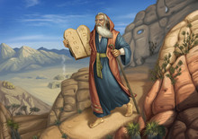
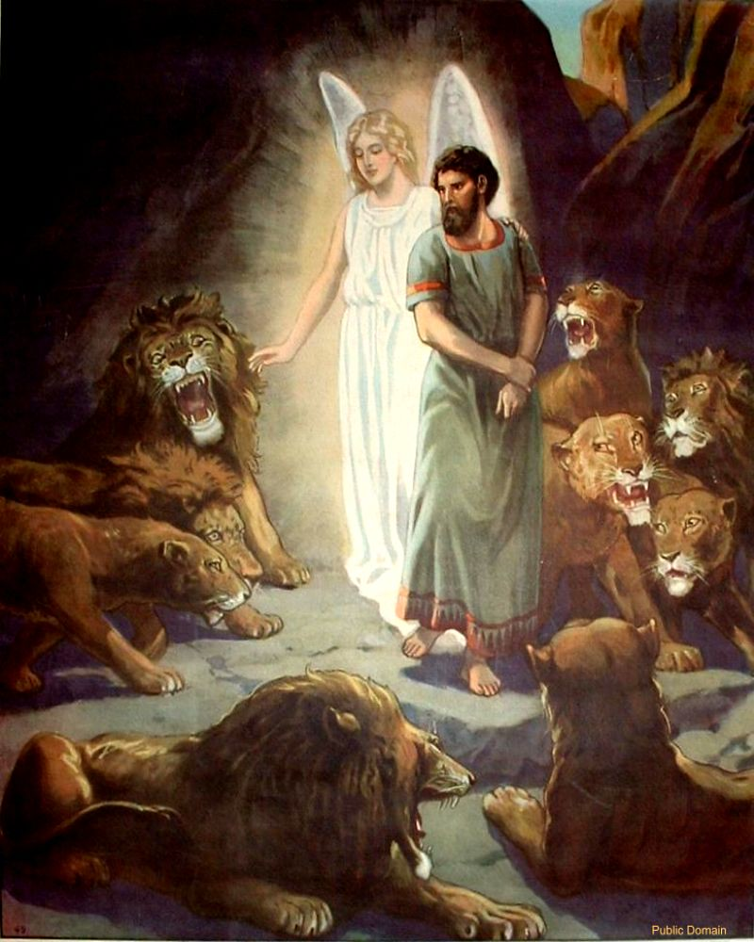
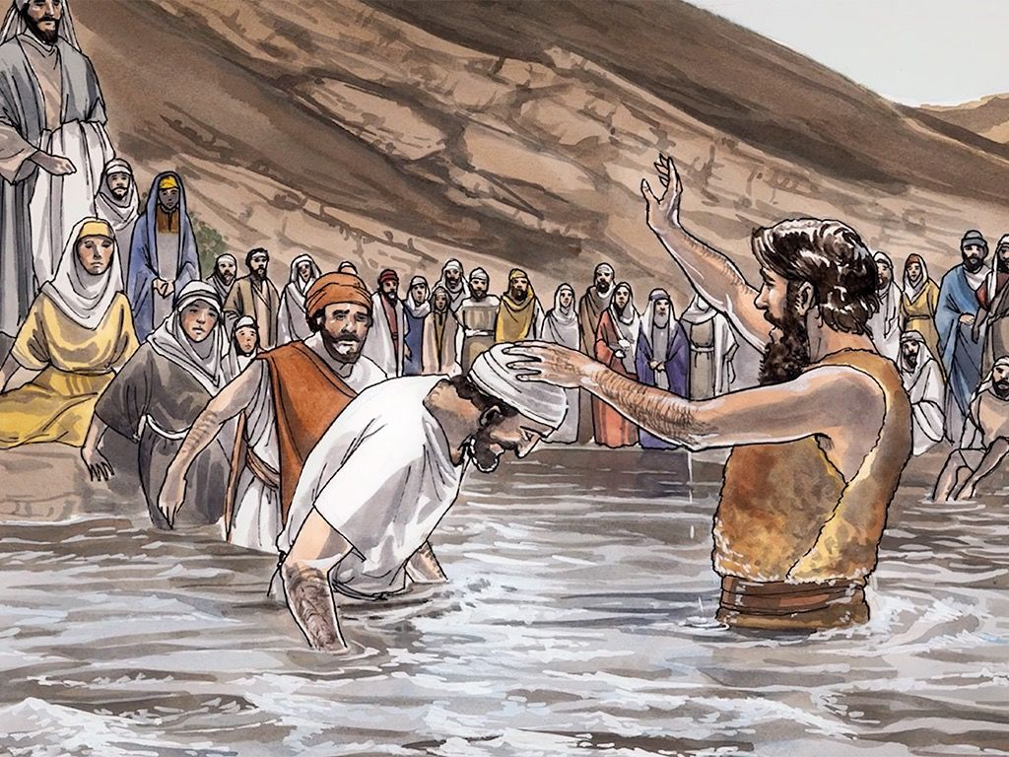
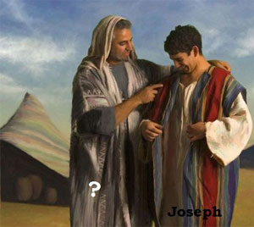
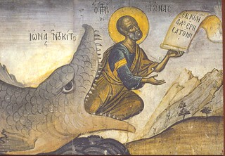
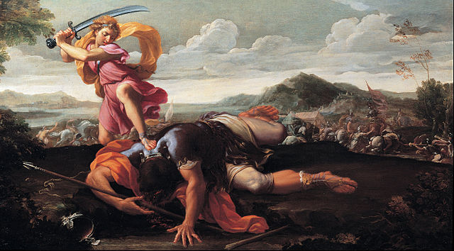
Who are these prophets from the Bible?
Notes:
Start by asking the children if they recognise the people in the pictures – Moses, David, Jonah, John the Baptist, Joseph and Daniel. Do they know the stories? Do they know what a prophet might be from the stories of these characters?
Pupils explore the concept of a prophet and why prophets are important in religious traditions. They begin by working in pairs to create a mind map that answers the question: 'What is a prophet?' This encourages them to think critically and collaboratively. Pupils then compare their own definitions with a formal dictionary definition, helping them refine their understanding.

Slide 4
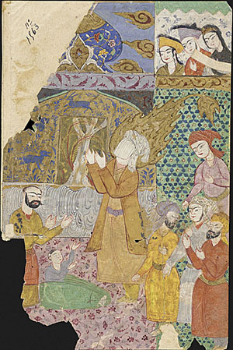
What is a prophet?
Notes:
Useful link to BBC website which explains prophets and prophecy in Christianity relating to Jesus – link on picture.

Slide 5
Lesson 2: Abraham
Notes:
Investigating Common Prophets

Slide 6
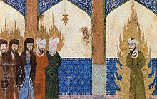
Notes:
How Abraham is portrayed in Christianity, Islam and Judaism…link on the picture.

Slide 7
Lesson 3: Jesus in Christianity and Islam
Notes:
Comparing Views of Jesus

Slide 8
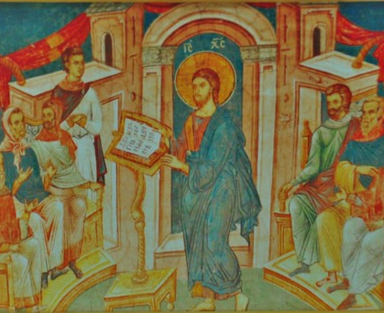
Notes:
Link to video on picture

Slide 9
Lesson 4: Muhammad – Seal of the Prophets
Notes:
Exploring the Concept of the Seal

Slide 10
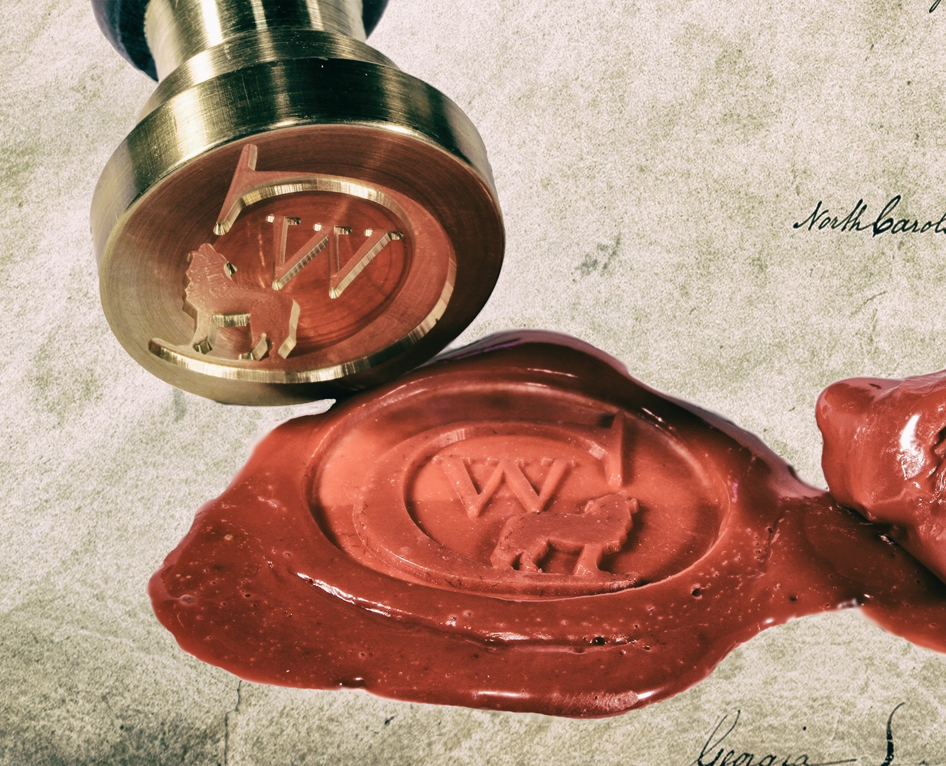
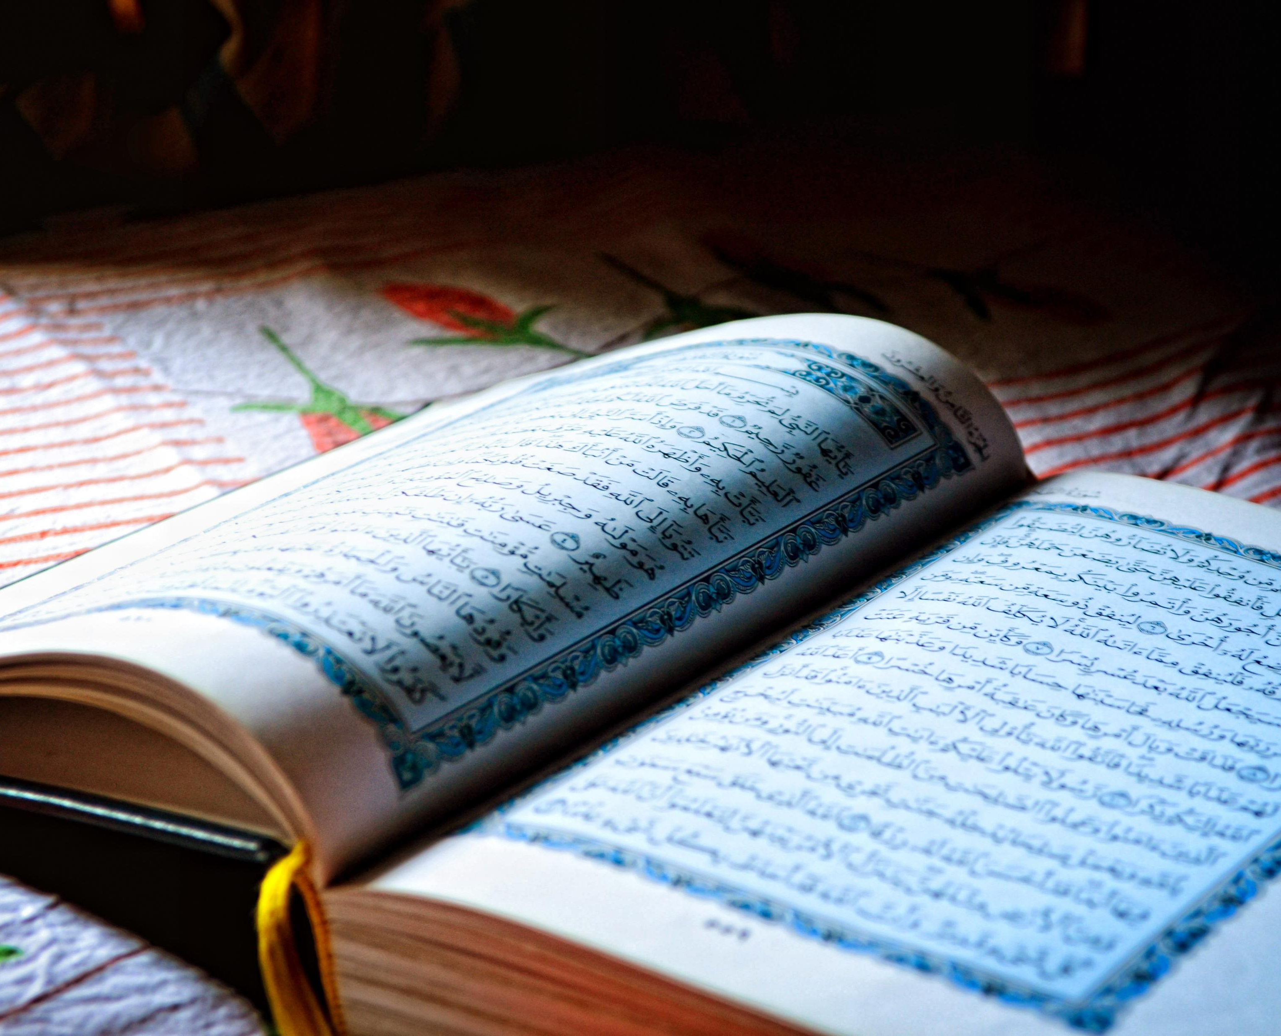
Who is the Seal of the Prophets?
Notes:
This lesson introduces pupils to the concept of Muhammad as the 'Seal of the Prophets' in Islam. Pupils begin by investigating what a seal is, using everyday examples like a jam jar or a wax stamp. They can create their own seals using candle wax and stampers, making the concept tangible and memorable. The class could play a game of Chinese Whispers to illustrate how messages can change when passed through many people, reinforcing the importance of preserving the original message of God. Pupils learn that Muslims believe Muhammad received the final and complete message from God through the Angel Jibril, and that this message is recorded in the Qur’an. Muhammed is known as the seal, as he is believed by Muslims to be the final messenger from God. Link to useful BBC video on picture of Qur’an.

Slide 11
Lessons 5&6 – Use oak academy
Notes:
Prophet Muhammad: how does he inspire Muslims today? KS2 | Y4 Religious education Lesson Resources | Oak National Academy
Use Lessons 4 and 5 to complete the overall unit.

