Slide 1
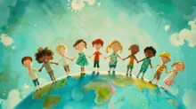
How Christians Around the World Celebrate Key Events

Slide 2
Lesson 1: Christianity as a Global Faith
Notes:
Christianity as a Worldwide Religion

Slide 3
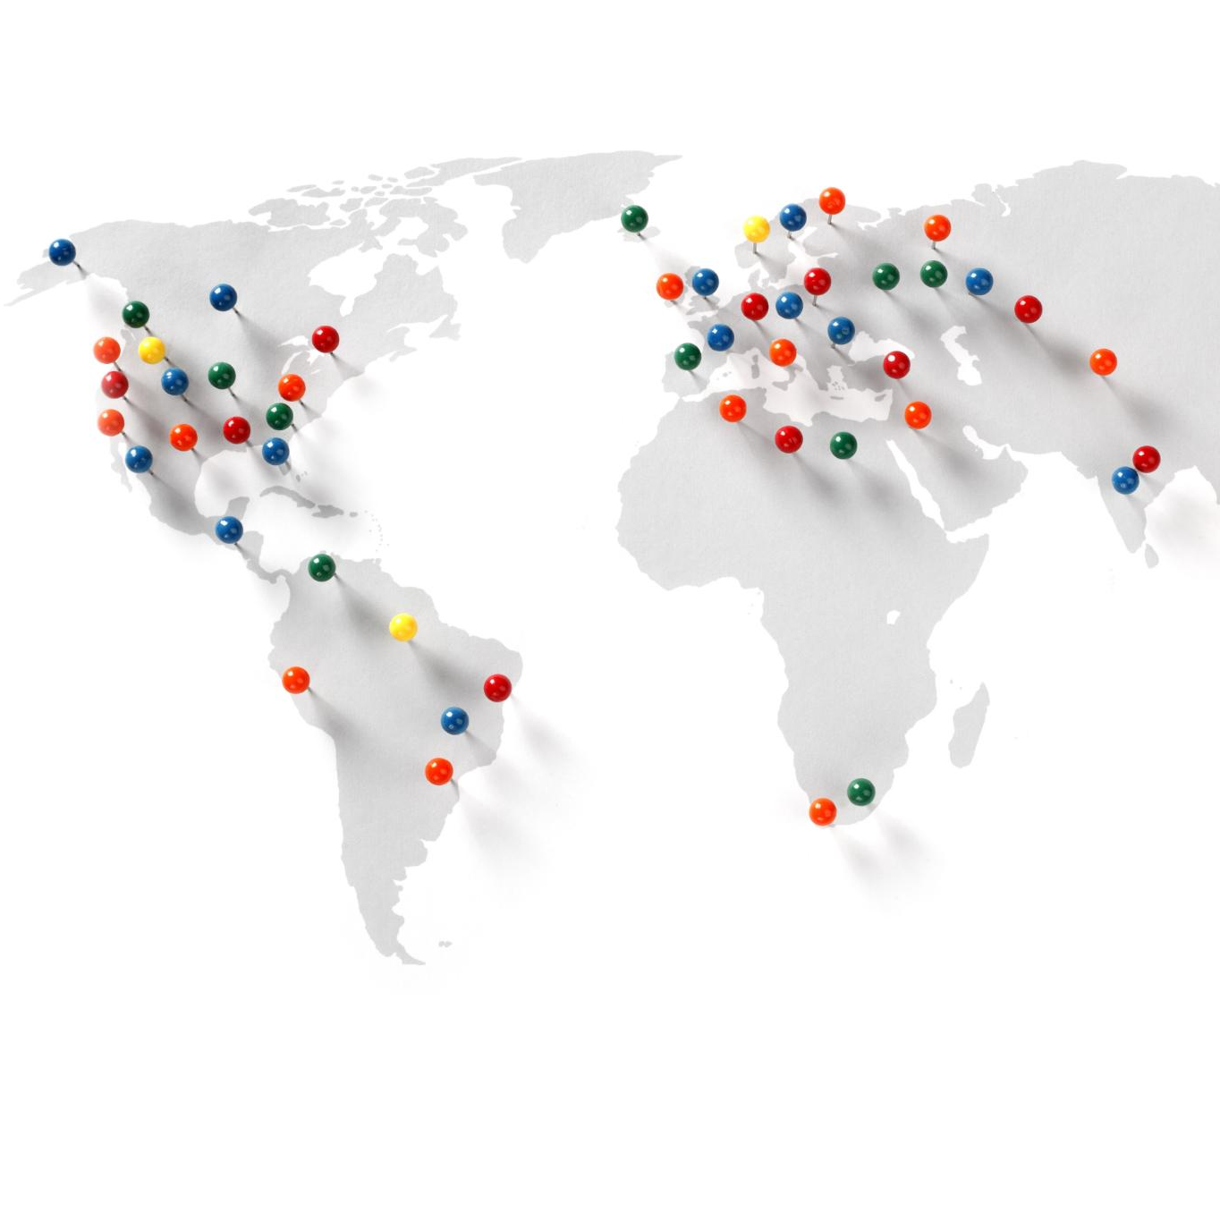
Notes:
Also look at Oak National Academy Y6 Unity on The Church and Diversity for helpful information
Christianity is one of the largest religions in the world, with followers living in almost every country. It began over 2,000 years ago and has grown into a global faith with many different traditions and practices. Christians share core beliefs, such as following Jesus Christ and reading the Bible, but the way they celebrate important events can vary greatly depending on culture and location. For example, Christians in Africa, Europe, Asia, and the Americas all celebrate Christmas and Easter, but their customs reflect local foods, music, and decorations. This diversity shows how Christianity adapts to different cultures while keeping its central message of love and faith. Maps and icons can help us see where these traditions happen and remind us that Christianity is not limited to one country or culture. Understanding this global nature helps us appreciate that people can share the same faith while expressing it in unique ways. This lesson introduces the idea that Christianity is both united and diverse, making it a truly worldwide religion.
Children’s activity - Have a look at this map of the world. (Use other maps that the children can handle to compare with the map and find out where different countries are) Do you know where you live? Do you think you can work out where any of the pins are in this map? Have you visited any of these places? The pins show where Christianity is a key part of the beliefs of the people in these areas – and these are just some of the areas where Christianity is practiced. Are you surprised by anything you spot on the map?

Slide 4
Lesson 2: Christmas Celebrations Worldwide
Notes:
How Christmas is Celebrated Globally

Slide 5

Lesson 2: Christmas Celebrations Worldwide
Notes:
Talk to the children about whether they celebrate Christmas and how.
Watch this video of what Christmas means to these young English Christians…are there any similarities/differences between their Christmas and how the children in your class celebrate?
Explain that people all over the world celebrate Christmas in different ways and that as a class you are going to research some of the ways that people around the world celebrate Christmas.

Slide 6
Regional and Cultural Differences in Christmas
Country | Christmas Tradition
Kenya
Iceland
Ukraine
Japan
South Africa
Notes:
Also look at Oak National Academy Y3 Unit on Festivals – Lessons 4,5 &6
Christmas is celebrated by Christians to remember the birth of Jesus Christ, but the customs vary widely across the globe.
Activity – Divide the class into 5 groups – each group could use IT to research the traditions of the countries above and create a short presentation to the rest of the class.
Clues for teachers:
In Kenya, homes and churches are decorated with colourful balloons, ribbons, and flowers, creating a joyful atmosphere.
In Iceland, there is a unique legend about the Yule Cat, a giant creature that roams the countryside during Christmas time.
Ukraine has a tradition of decorating with spider webs, which symbolize good luck.
In Japan, a modern custom involves eating Kentucky Fried Chicken on Christmas Eve.
In South Africa, some families include fried caterpillars in their festive meal.
These examples show how Christmas traditions reflect local culture and history, making the holiday both familiar and unique in different parts of the world.

Slide 7
Lesson 3: Easter Celebrations Worldwide
Notes:
How Easter is Celebrated Globally

Slide 8

How Easter is Celebrated Globally
Notes:
Talk to the children about whether they celebrate Easter and how.
Watch this video of some young children celebrating Easter with their families in a Catholic…are there any similarities/differences between their Easter and how the children in your class celebrate?
Explain that people all over the world celebrate Easter in different ways and that as a class you are going to research some of the ways that people around the world celebrate Easter.

Slide 9
How Easter is Celebrated Globally
Country | Easter Tradition
Kenya
Italy
Greece
Australia
Bermuda
Notes:
Easter is the most important Christian festival, celebrating the resurrection of Jesus. It begins with Lent, a 40-day period of reflection and preparation, followed by Holy Week, which includes Palm Sunday and Good Friday. Around the world, Easter customs vary.
Activity – Divide the class into 5 groups – each group could use IT to research the traditions of the countries above and create a short presentation to the rest of the class.
Clues for teachers:
In Kenya, families enjoy chicken or beef stew, and some husbands wash their wives’ feet as a sign of humility.
In Italy, Easter follows Carnevale, a festive season with parades and parties, and people eat sweet bread and eggs.
In Greece, red eggs are tapped together in a game of luck, and roasted lamb is served.
Australia has an Easter bilby instead of a bunny to raise awareness about native animals.
In Poland, boys sprinkle girls with water or perfume on Easter Monday.
In Bermuda, colourful kites are flown to symbolize Christ’s resurrection.
These traditions show how Easter combines religious meaning with cultural creativity, making it a joyful and diverse celebration worldwide.

Slide 10
Lesson 4: Baptism / Christening
Notes:
Understanding Baptism

Slide 11
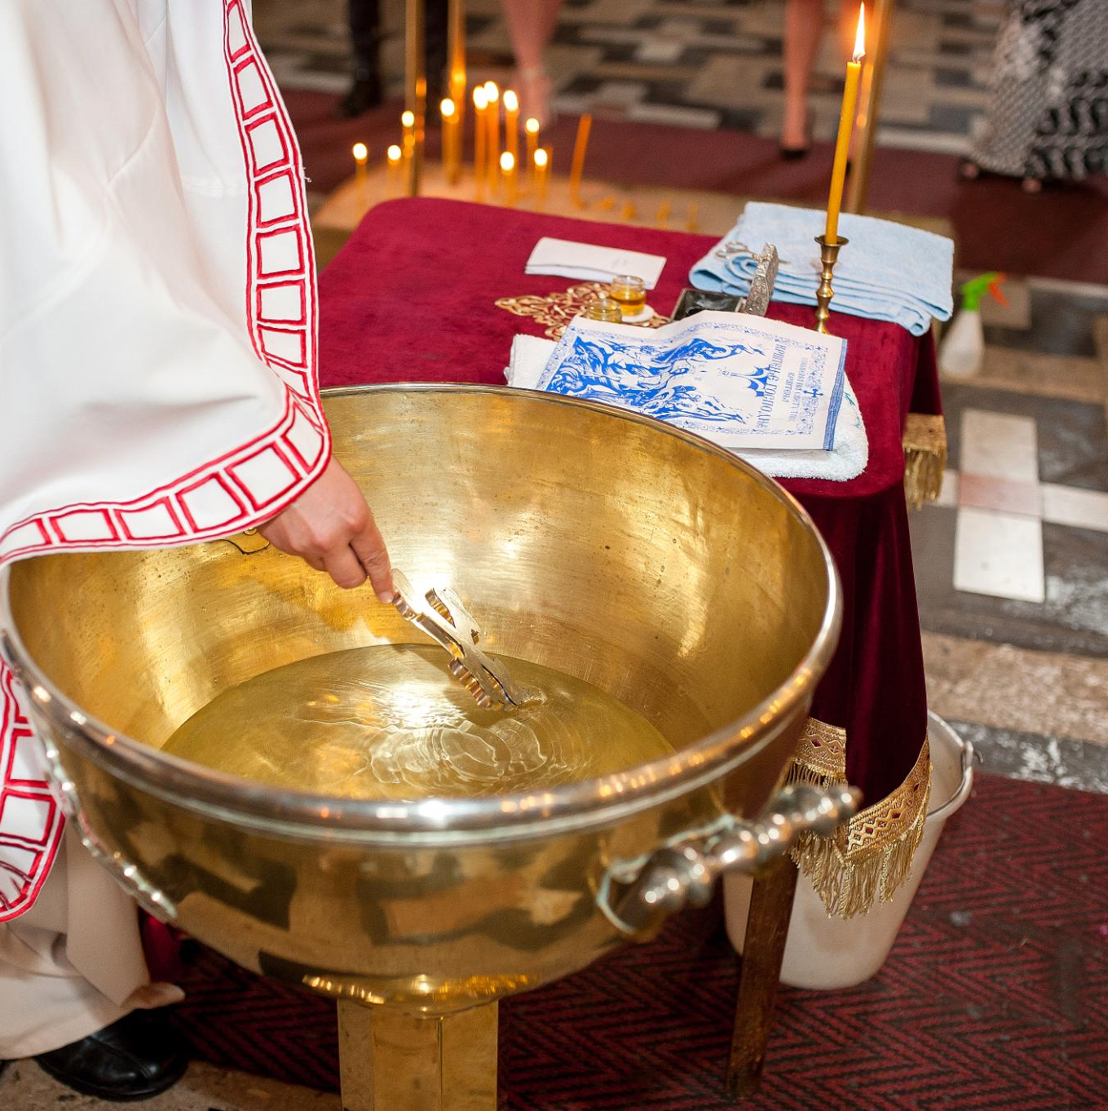
Understanding Baptism
Symbolism and Meaning
  Baptism symbolizes entry into the Christian faith and the washing away of sin, marking a spiritual new beginning.
Types of Baptism
  Infant baptism involves baptizing babies, while believer’s baptism is for adults choosing to follow Jesus.
Varied Practices
  Different Christian denominations practice baptism uniquely, including immersion, sprinkling water, and ritual hair cutting.
Common Ritual Elements
  Common elements include prayers, wearing white clothes, and lighting candles during the baptism ceremony.
Notes:
Also look at Oak National Academy Y3 Unit on Rites of Passage Lessons 1&2
Baptism is a special ceremony in Christianity that symbolises being welcomed into the faith and receiving God’s grace – grace is another word for gift. It is based on the example of John the Baptist, who baptised Jesus. Christians believe baptism washes away sins and marks a new beginning. There are two main types: infant baptism, where babies are baptised, and believer’s baptism, for adults who choose to follow Jesus. Most denominations include prayers, wearing white clothes, and lighting a candle. However, practices differ: Orthodox Christians immerse infants fully in water and cut a lock of hair, while Catholics and Protestants often sprinkle water on the head. Baptists and Pentecostals baptise adults by immersing them completely in water. These differences show how baptism is both a shared and varied tradition, reflecting the richness of Christian worship.

Slide 12
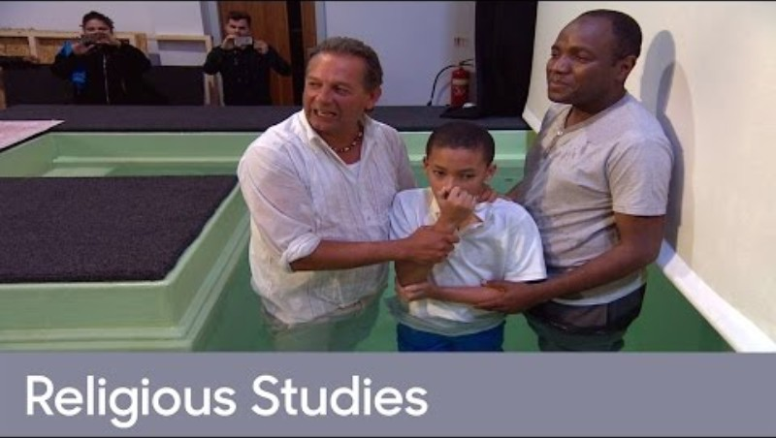
Understanding Baptism
Notes:
Watch this video – what do the children think about any aspect of what is explained in this example of Pentecostal Baptism?

Slide 13
Lesson 5: Holy Communion
Notes:
Holy Communion

Slide 14
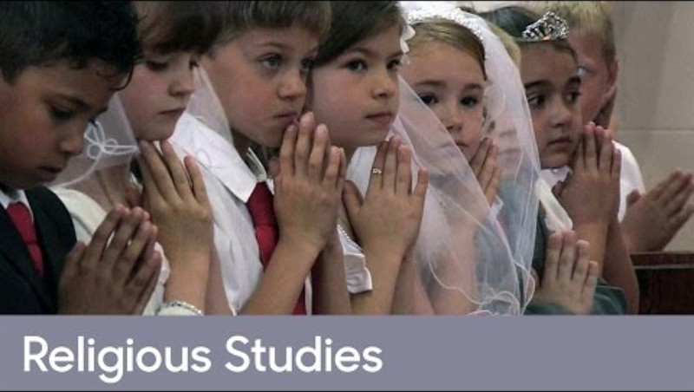
What is Holy Communion?
Notes:
Watch this video about how Catholic Christian children prepare to receive their first Holy Communion. Is this something that the children in your class are aware of? There is lots to discuss here so just see where the lesson takes you.

Slide 15
Lesson 6: Getting Married
Notes:
Getting Married

Slide 16
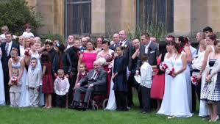
Why is Marriage important to Christians and how do they celebrate?
Notes:
Christian Marriage - TrueTube

Slide 17
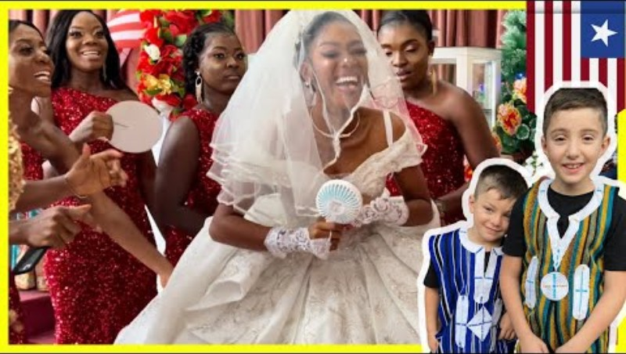
Why is Marriage important to Christians and how do they celebrate?
Notes:
Watch this video of a Liberian Christian Wedding and compare with that of the wedding in the UK – similarities and differences??

