Slide 1
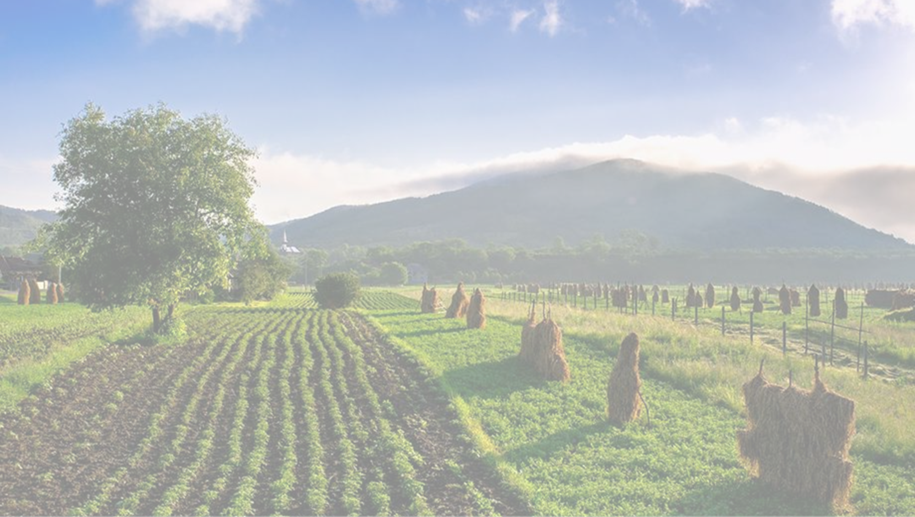
The Harvest Season
Living in the world that we have been given
Yours, Lord, is the greatness, the power,
the glory, the splendour, and the majesty;
for everything in heaven and on earth is yours.
All things come from you,
and of your own do we give you.

Slide 2
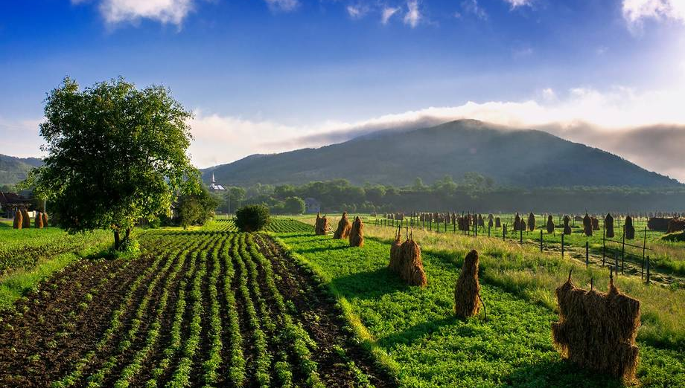
Fruitfulness amongst animals
From Day 3 of the Creation Story…
God was pleased with what he saw. Then he commanded, “Let the earth produce all kinds of plants, those that bear grain and those that bear fruit”—and it was done. So the earth produced all kinds of plants, and God was pleased with what he saw.

Slide 3
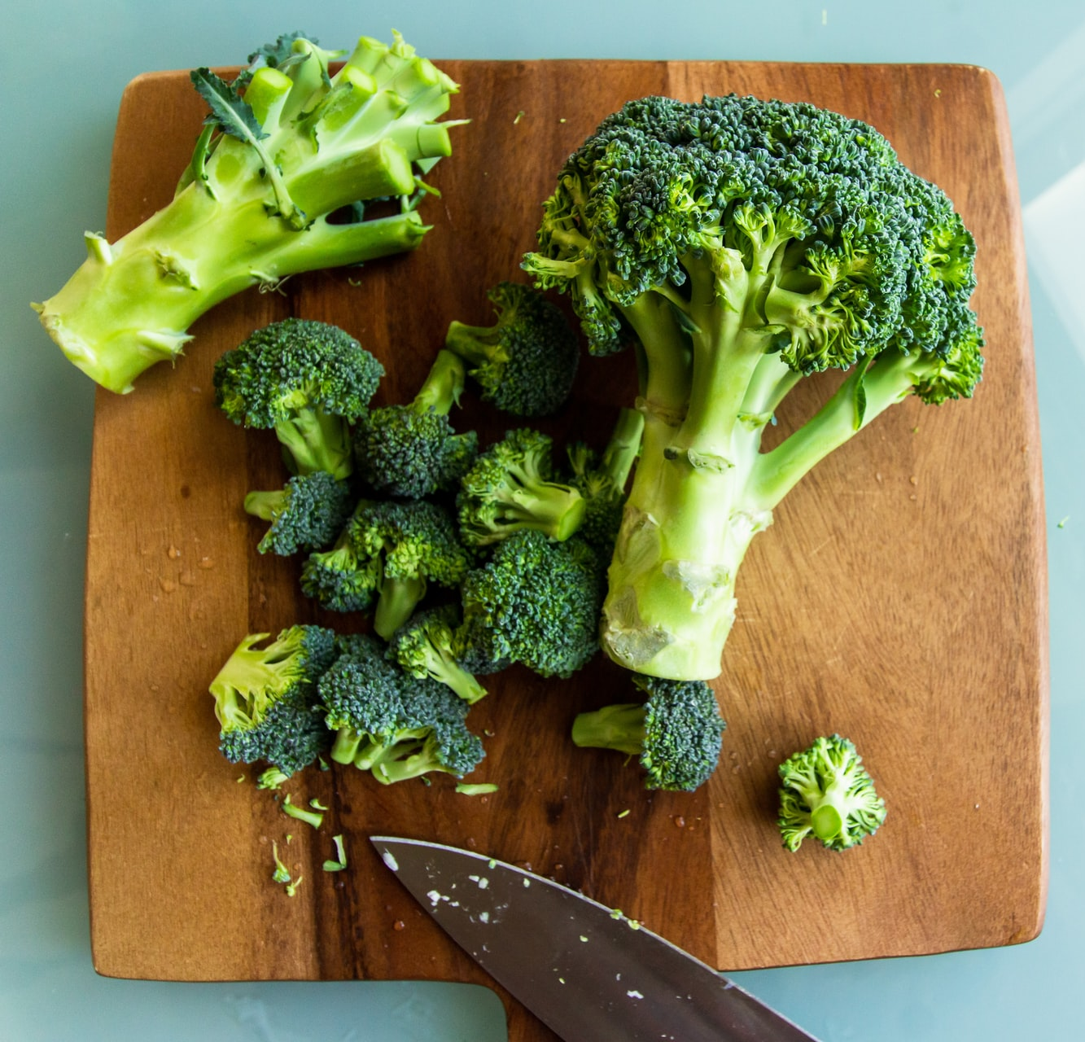
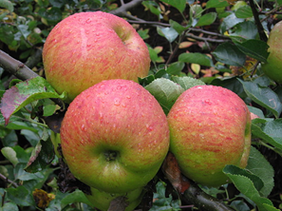
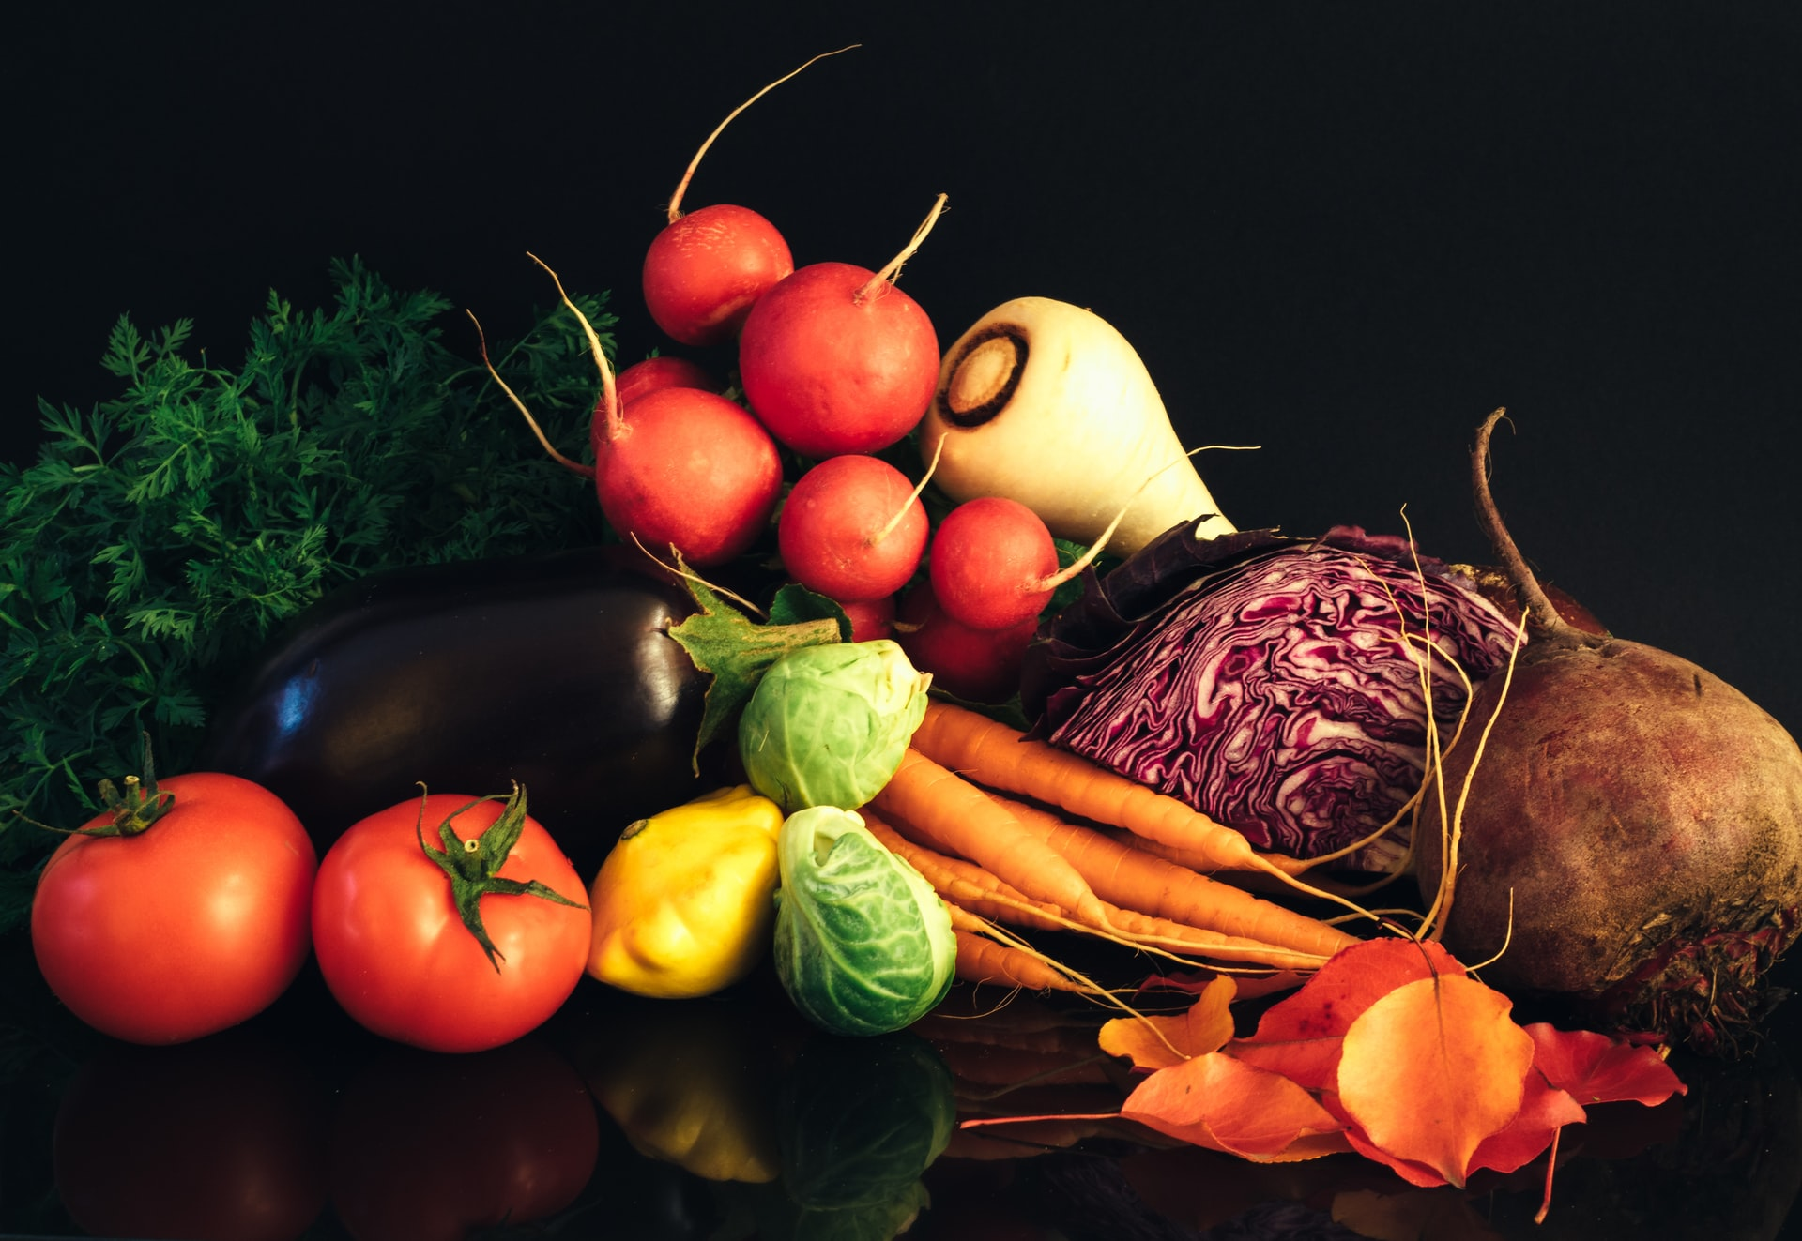
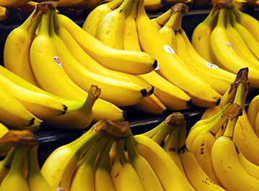
Do you have a favourite vegetable or fruit?
Why do you like them?
Talk to a neighbour about what you like.
Notes:
Gather ideas from pupils
This is an opportunity to celebrate diversity and difference

Slide 4
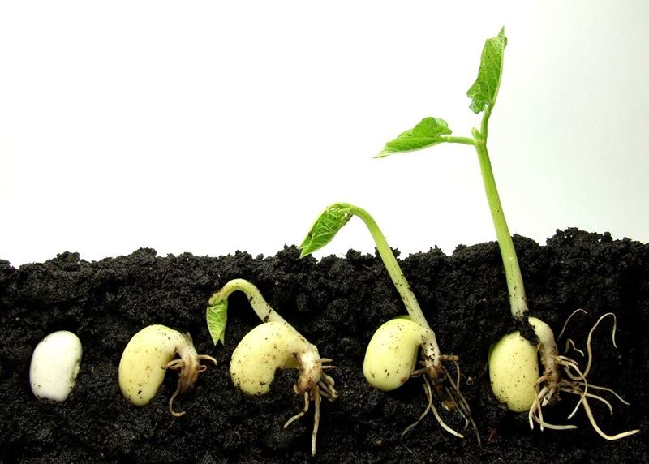
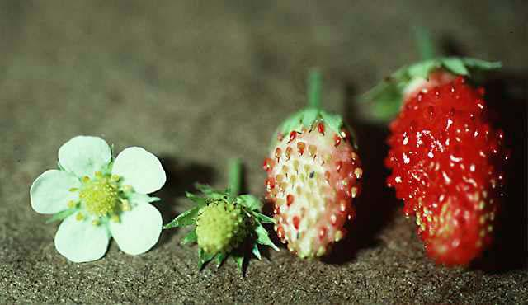
Plants change as they grow…
From seed to fruit …
We change as we grow too…
Do people have fruit?

Slide 5
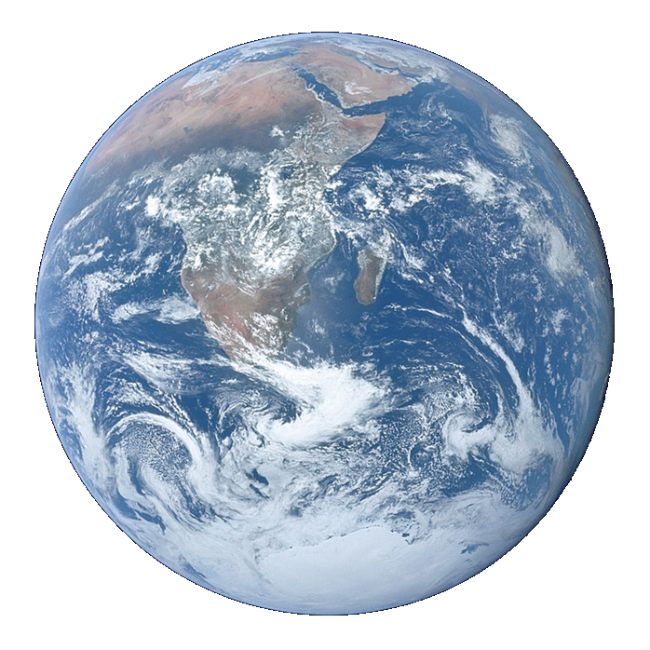
Litany of Creation
God commanded, “Let the earth produce all kinds of plants”
Plant prayers
God commanded, “Let the water be filled with many kinds of living beings, and the air filled with birds.”
Fish and bird prayers
God commanded, “Let the earth produce all kinds of animal life”
Animal prayers
God created human beings and blessed them,
People prayers
God looked at everything and was very pleased.
Thank you prayer
Notes:
An optional structure for prayer – see Developmental Prayer File page15* Pupils’ own prayers (or perhaps parents’ or staff prayers) should be inserted at the points in italics. This could be an opportunity to involve extemporary prayer or for silent prayer/reflection.
*https://www.odbe.org.uk/content/pages/documents/collectiveworship-prayerfile-doc-202175554553377.pdf

Slide 6
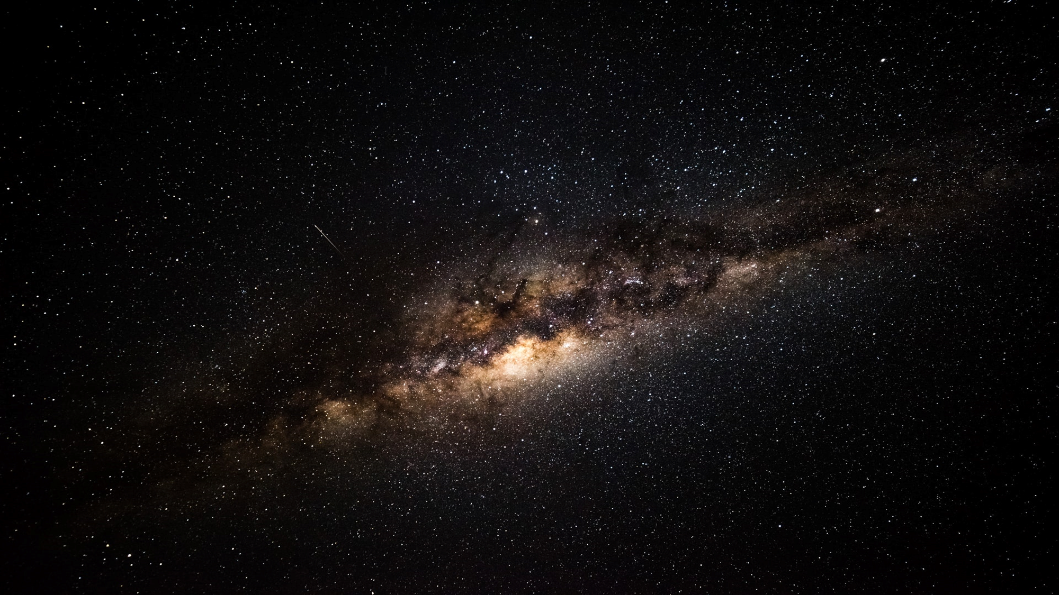
Our Father in heaven,
hallowed be your name,
your kingdom come,
your will be done,
on earth as in heaven.
Give us today our daily bread.
Forgive us our sins
as we forgive those who sin against us.
Lead us not into temptation
but deliver us from evil.
For the kingdom, the power,
and the glory are yours
now and for ever.
Amen.

