Slide 1
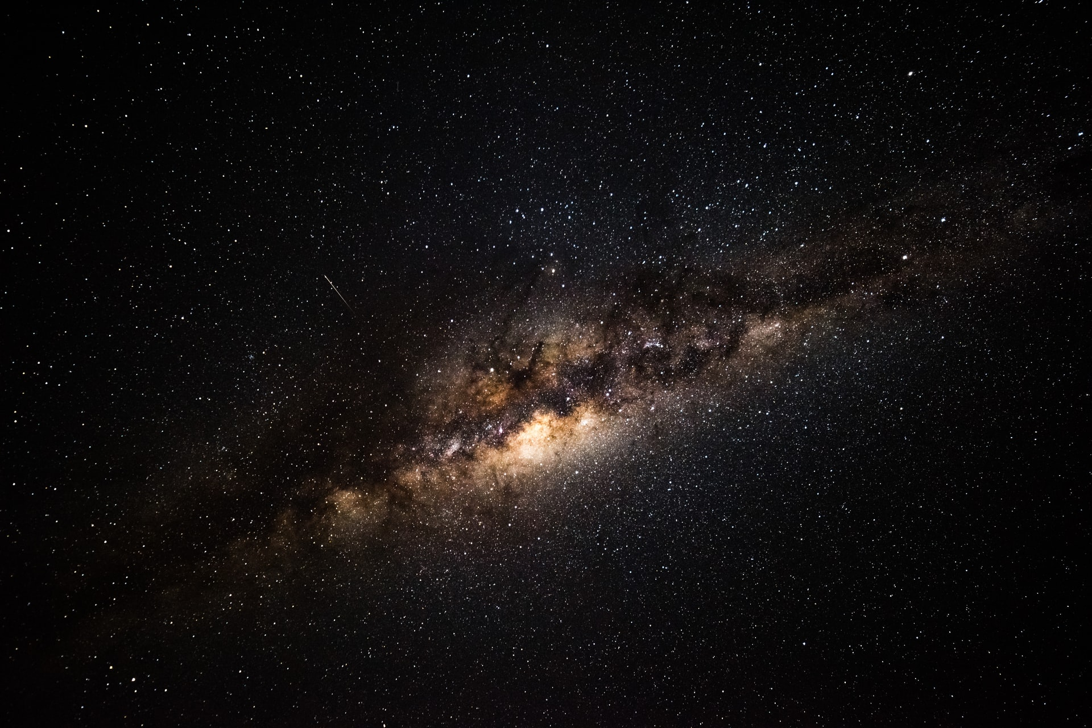
Harvestime
Living in the world that we have been given
Yours, Lord, is the greatness, the power,
the glory, the splendour, and the majesty;
for everything in heaven and on earth is yours.
All things come from you,
and of your own do we give you.
Notes:
The Christian prayer on this slide is used regularly used in church services.
It is taken from the Old Testament and is an expression of the Christian faith in a God who is the creator of the whole world. Not just the Earth but all the starts and planets – the whole universe.

Slide 2
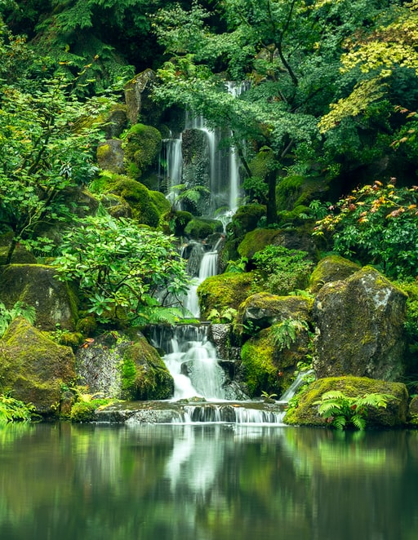
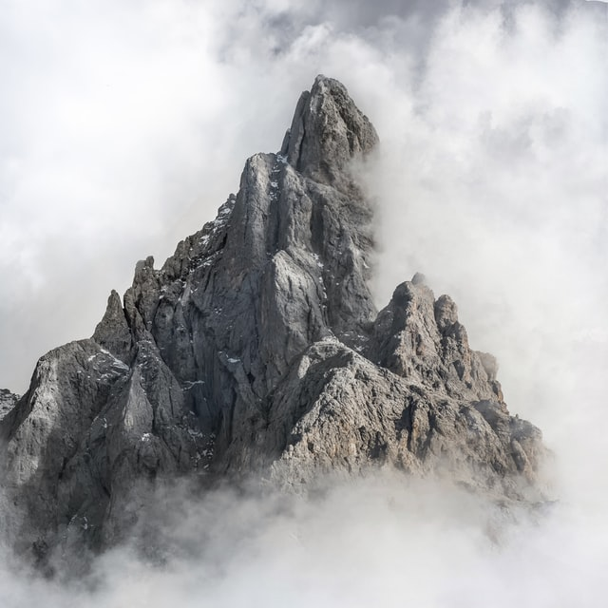
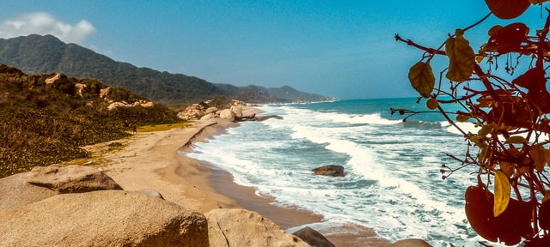
Yours, Lord, is the greatness, the power,
the glory, the splendour, and the majesty;
for everything in heaven and on earth is yours.
All things come from you,
and of your own do we give you.
Which parts of our world are great or powerful or glorious or splendid or majestic?
‘Nature is the art of God’ — Dante Alighieri
Notes:
Dante Alighieri wrote the famous Divine Comedy, not a children’s book of course!

Slide 3
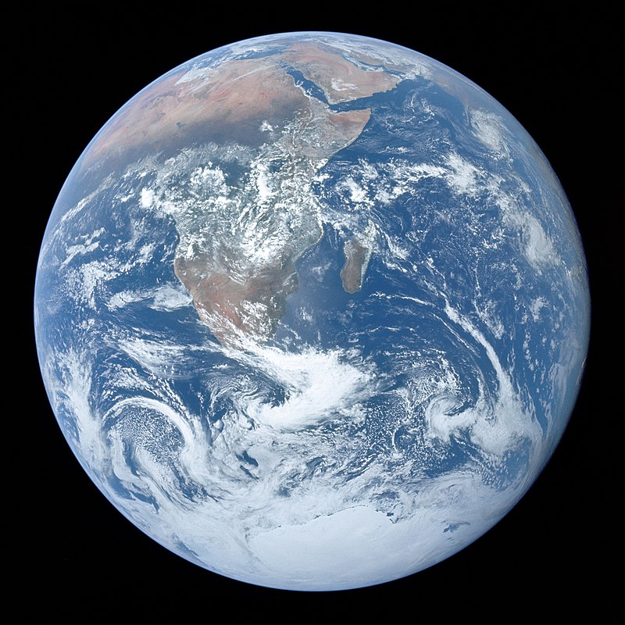
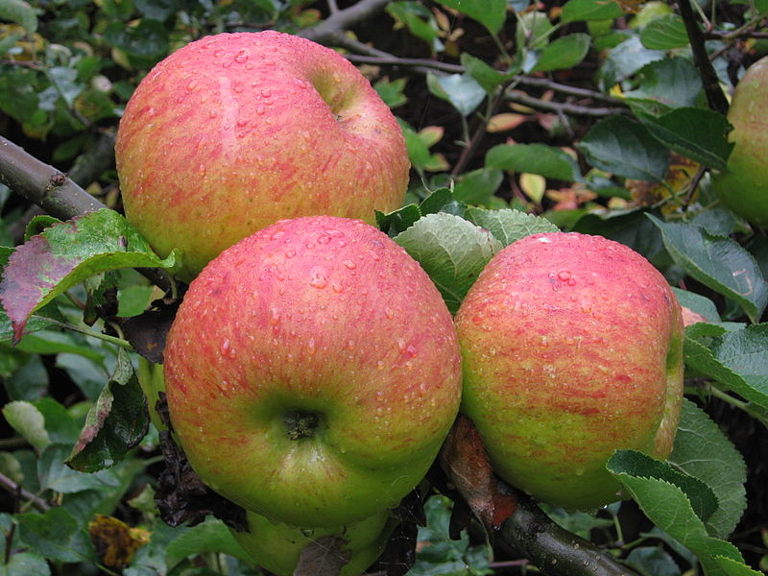
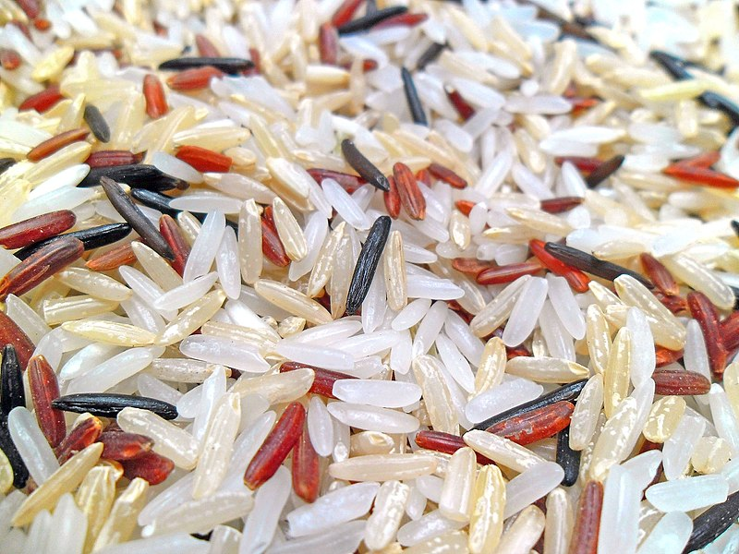
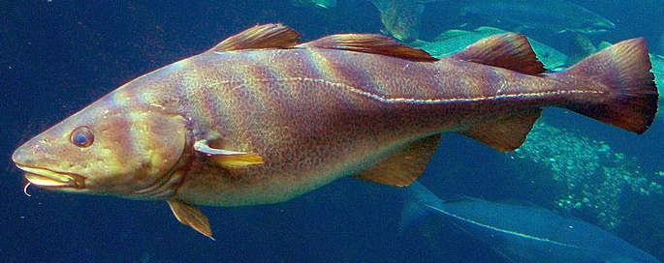
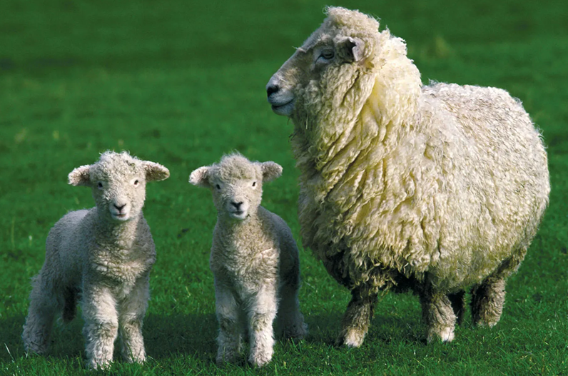
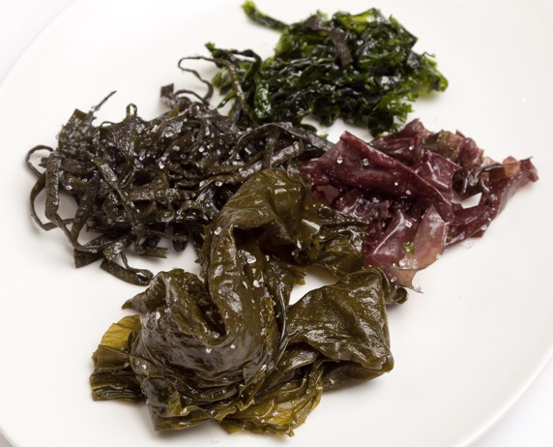
Notes:
The creation story in the Bible says …
God created humans[e] in his image,
in the image of God he created them;[f]
male and female he created them.
God blessed them, and God said to them, “Be fruitful and multiply and fill the earth and subdue it and have dominion over the fish of the sea and over the birds of the air and over every living thing that moves upon the earth.” God said, “See, I have given you every plant yielding seed that is upon the face of all the earth and every tree with seed in its fruit; you shall have them for food.
God’s words are about harvest
There are harvests everywhere in the world
Well pretty much – at least where people live
We mostly think of harvest as food but there are other things that are harvested too

Slide 4
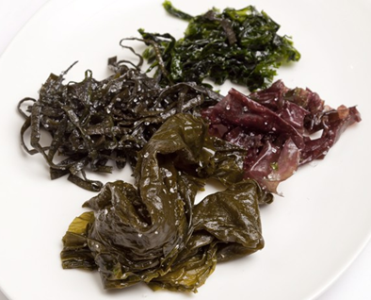
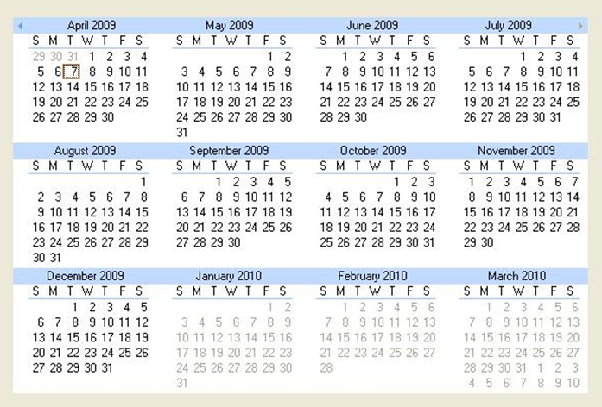
Notes:
There are harvests everywhen in the world too

Slide 5
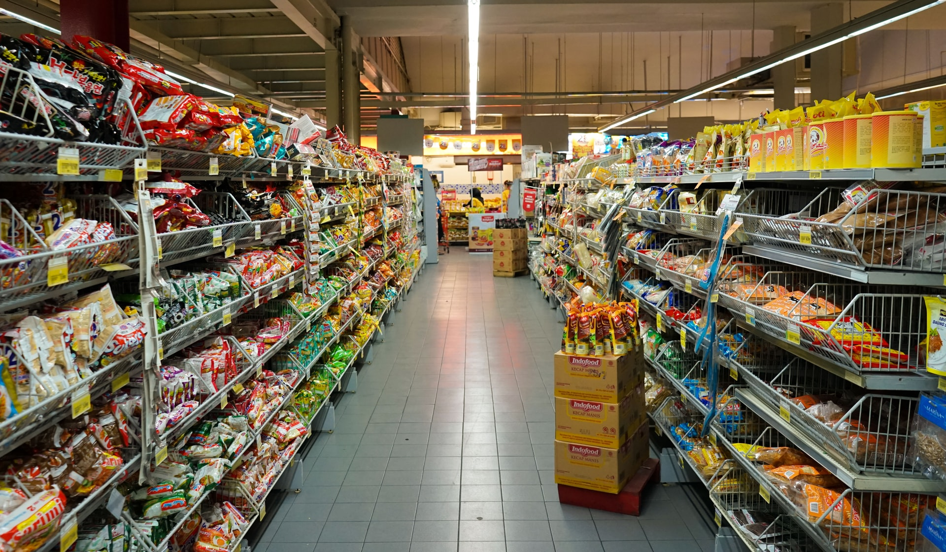
Do you ever go to the shops?
Which shops do you like best?
What kind of things do you like best?
Food
Clothes
Toys
Games
Where do the things come from?
Notes:
Remember the prayer at the beginning – Christians believe that everything comes from God and that everything is a gift from God.
This is also the belief of other faiths – you may wish to invite parents or people from other faiths to talk about how they understand the world that we live in.
Of course, pupils may well be able to do this for themselves.

Slide 6
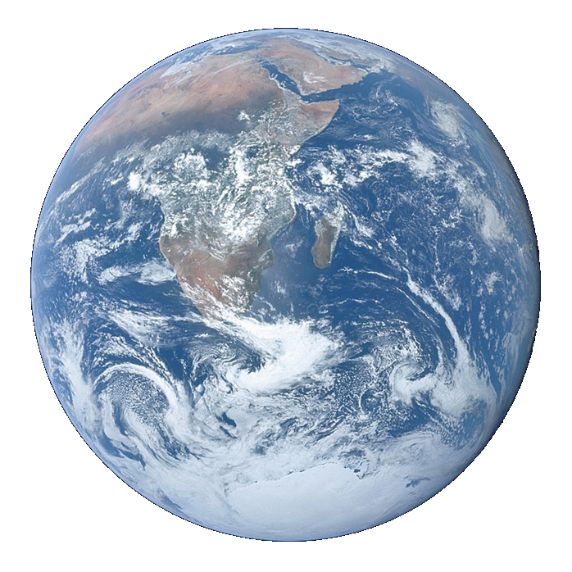
Litany of Creation
God commanded, “Let the earth produce all kinds of plants”
Plant prayers
God commanded, “Let the water be filled with many kinds of living beings, and the air filled with birds.”
Fish and bird prayers
God commanded, “Let the earth produce all kinds of animal life”
Animal prayers
God created human beings and blessed them,
People prayers
God looked at everything and was very pleased.
Thank you prayer
Notes:
An optional structure for prayer – see Developmental Prayer File page15* Pupils’ own prayers (or perhaps parents’ or staff prayers) should be inserted at the points in italics. This could be an opportunity to involve extemporary prayer or for silent prayer/reflection.
*https://www.odbe.org.uk/content/pages/documents/collectiveworship-prayerfile-doc-202175554553377.pdf

Slide 7
Our Father in heaven,
hallowed be your name,
your kingdom come,
your will be done,
on earth as in heaven.
Give us today our daily bread.
Forgive us our sins
as we forgive those who sin against us.
Lead us not into temptation
but deliver us from evil.
For the kingdom, the power,
and the glory are yours
now and for ever.
Amen.

