Slide 1
May God our Father give us grace and peace

Slide 2
Letters from long ago…
Some words from a letter that Paul wrote to the Christians in a town called Colossae.

Slide 3
You are the people of God; he loved you and chose you for his own. So then, you must clothe yourselves with compassion, kindness, humility, gentleness, and patience. Be tolerant with one another and forgive one another whenever any of you has a complaint against someone else. You must forgive one another just as the Lord has forgiven you. And to all these qualities add love, which binds all things together in perfect unity. Colossians 3:12-15

Slide 4
What did the reading make us think?
Were there any words that were difficult to understand?

Slide 5
Paul writes about ‘clothing’ ourselves
Does he mean wearing T-shirts with words on them?

Slide 6
kindness
compassion
humility
gentleness
patience
Notes:
Read the words through – but don’t dwell too long on this slide.

Slide 7
Or does he mean something else?
Let’s look at some pictures…
Notes:
Ask these questions and go straight on, save any responses until later.
Each picture has a suggestion with it – other suggestions from children will be equally appropriate.

Slide 8
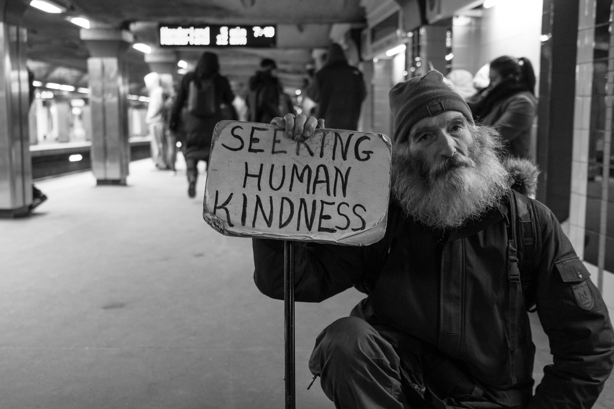
Notes:
Kindness

Slide 9
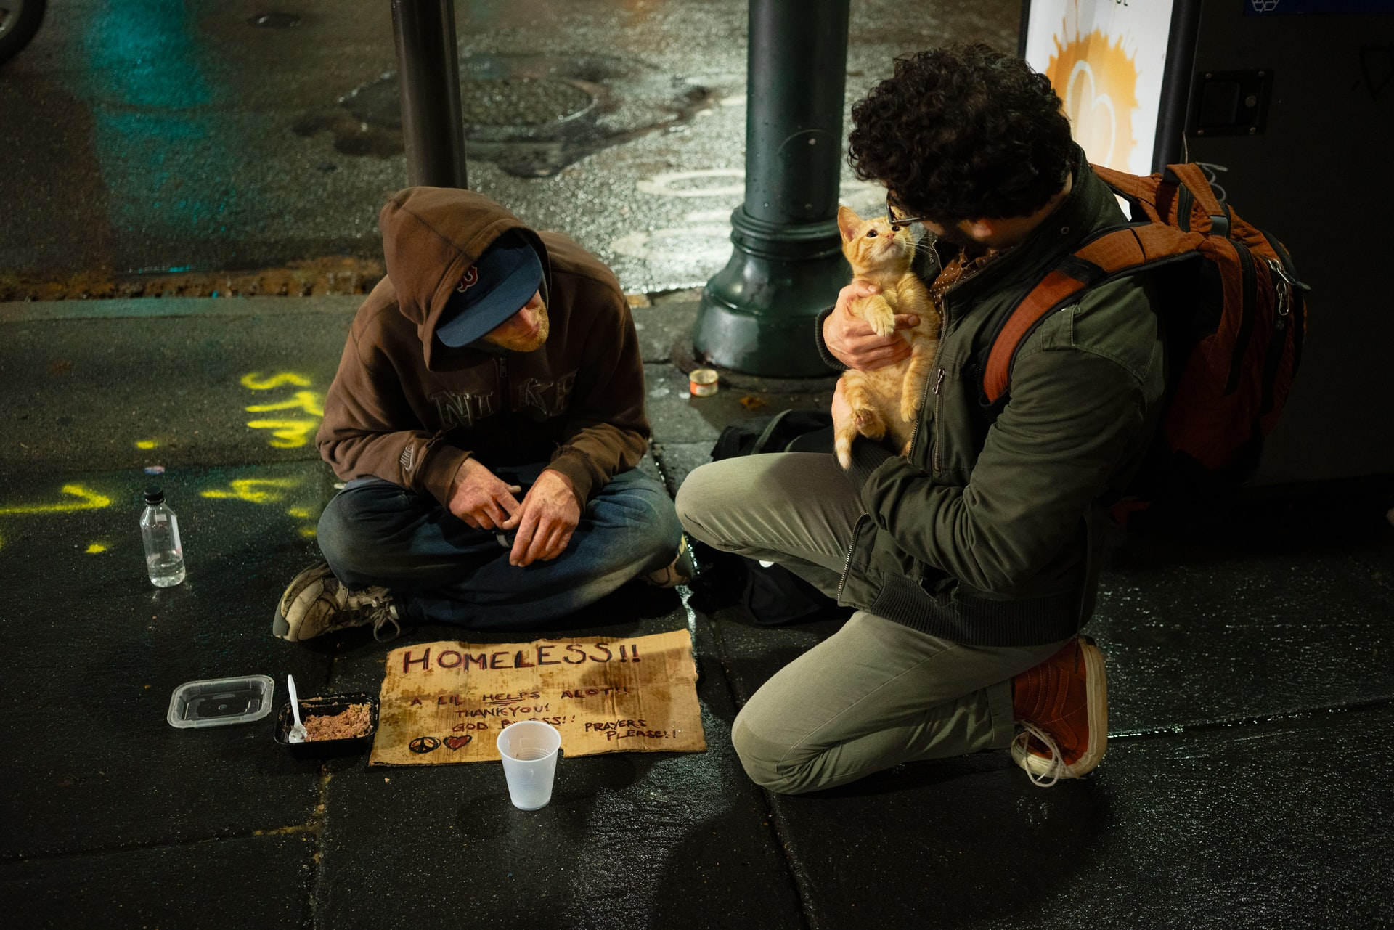
Notes:
Compassion

Slide 10
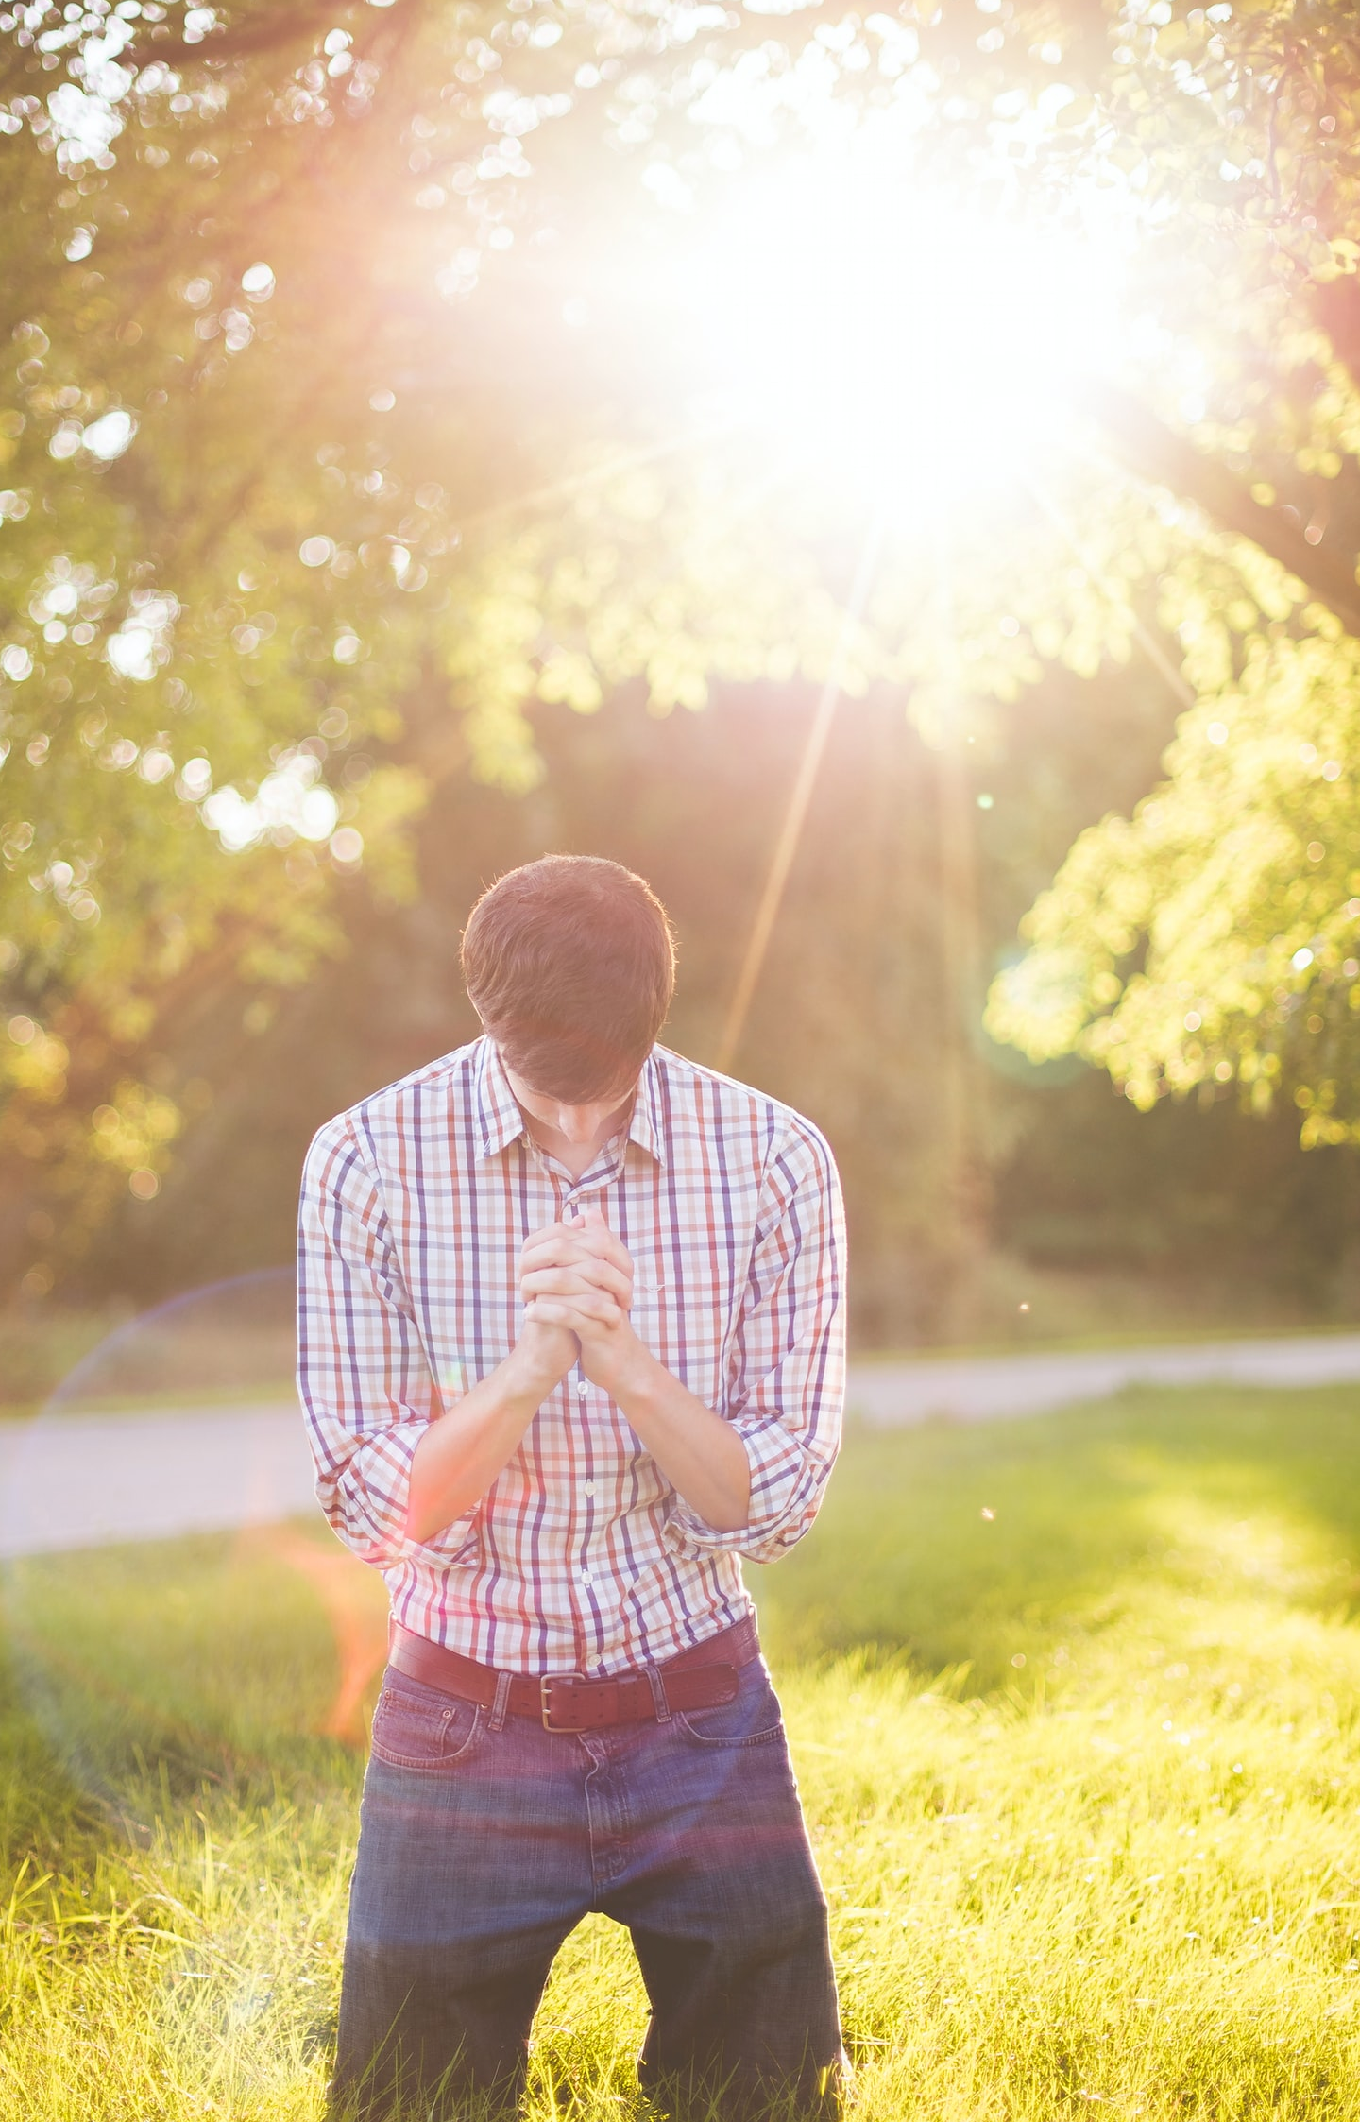
Notes:
Humility

Slide 11
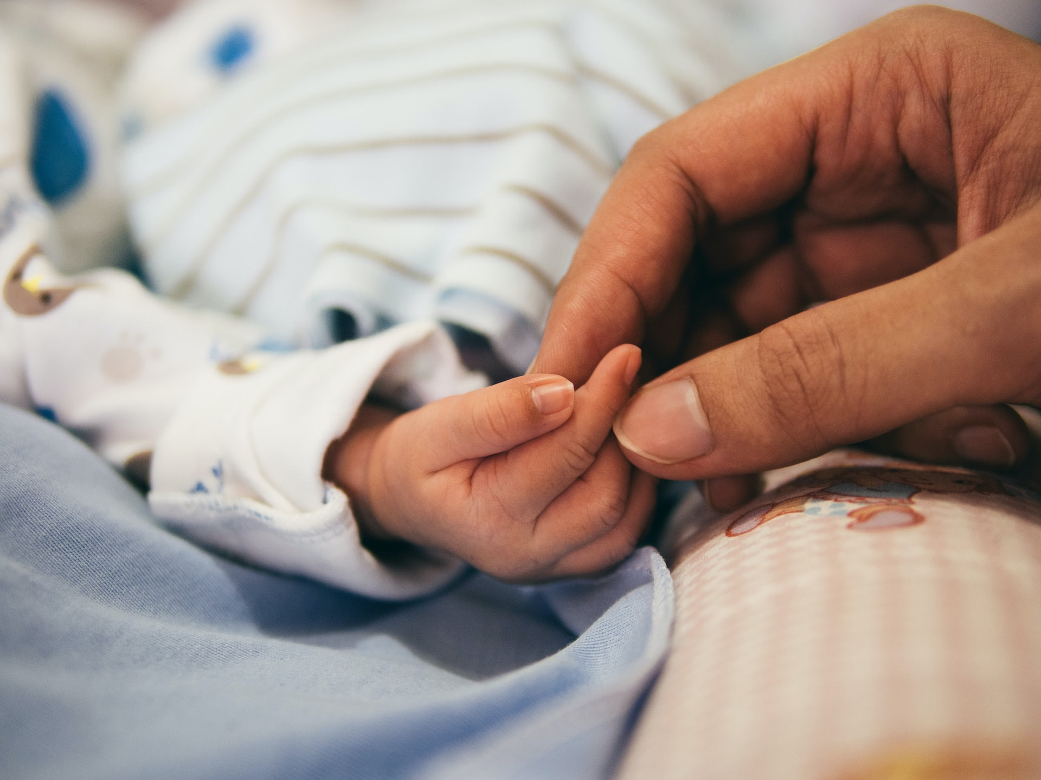
Notes:
Gentleness

Slide 12
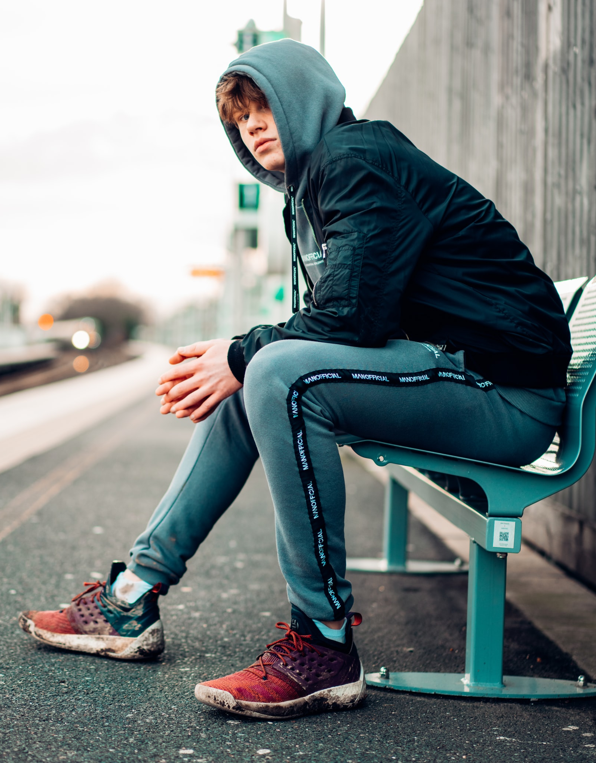
Notes:
Patience!

Slide 13
Which T-shirt would you like to wear?
Notes:
A metaphorical question
We should – perhaps – try to embody all of humility, gentleness, kindness, compassion and patience.
However exploring which we are best at can be an enlightening activity. A good way to do this is to ask pupils to nominate others who show these qualities. Nobody can nominate themselves.

Slide 14
Loving Lord,
Thank you for our school, for all that we do and for everyone who works, plays and learns here
Help us to play our own parts in the life of school so that together we can be a strong and happy community.
Amen
Prayer
Notes:
A simple prayer.

Slide 15
The grace of the Lord Jesus Christ, the love of God, and the fellowship of the Holy Spirit be with us all.
Notes:
Closing slide

